Slide 1


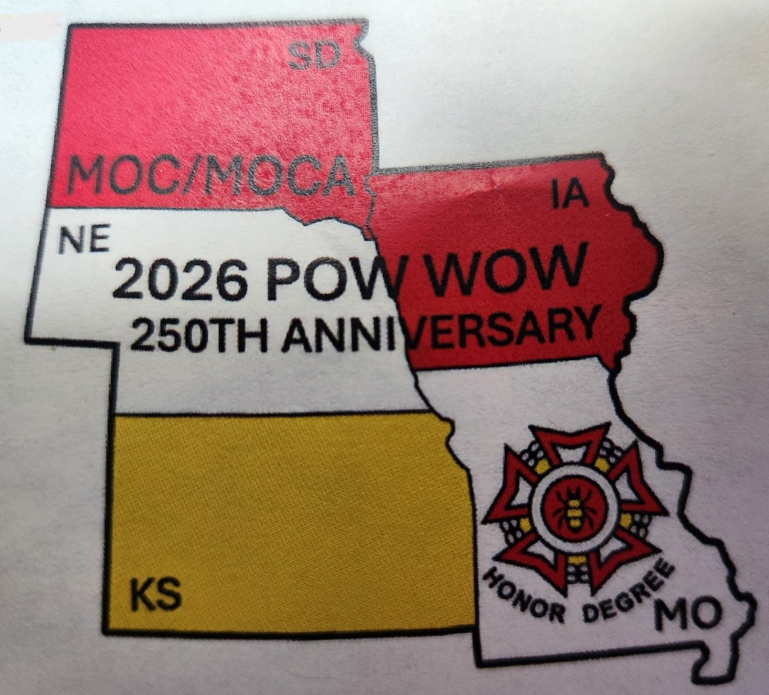
Military Order of the Cootie & Auxiliary
5 State Pow Wow
2-4 Oct 2026
Embassy Suites by Hilton Omaha
12520 Westport Parkway
La Vista, NE 68128
402-331-7400 mention Military Order of the Cootie
https://www.hilton.com/en/attend-my-event/militaryorderofthecooties/
Rooms: $110 plus tax includes breakfast
Deadline for Room Rate: 3 Sep 2026
Tentative Agenda
Friday, Oct 2 5:00pm Hospitality Room opens Presidential Suite
Saturday, Oct 3 9:00am-5:pm Pow Wow
12:00pm Lunch (provided with registration)
6:00pm Reception/Cash Bar
6:30pm Dinner (provided with registration)
Registration (per person) before 15 Sep _______ x $70.00 each = $__________
Checks Payable to: MOC Grand of Nebraska
Grand/State:________________________________
Name:_____________________________ Pup Tent #: _______
Name:_____________________________ Aux #:____________
Address:_____________________________________________
City/State/Zip:________________________________________
Phone:______________________________________________
Send reservations to:
Mark Talbert
9420 Green Valley Lane
Lincoln, NE 68516
(402)443-6131

