Slide 1


Department of California
Volunteer Suicide Intervention Training

Slide 2
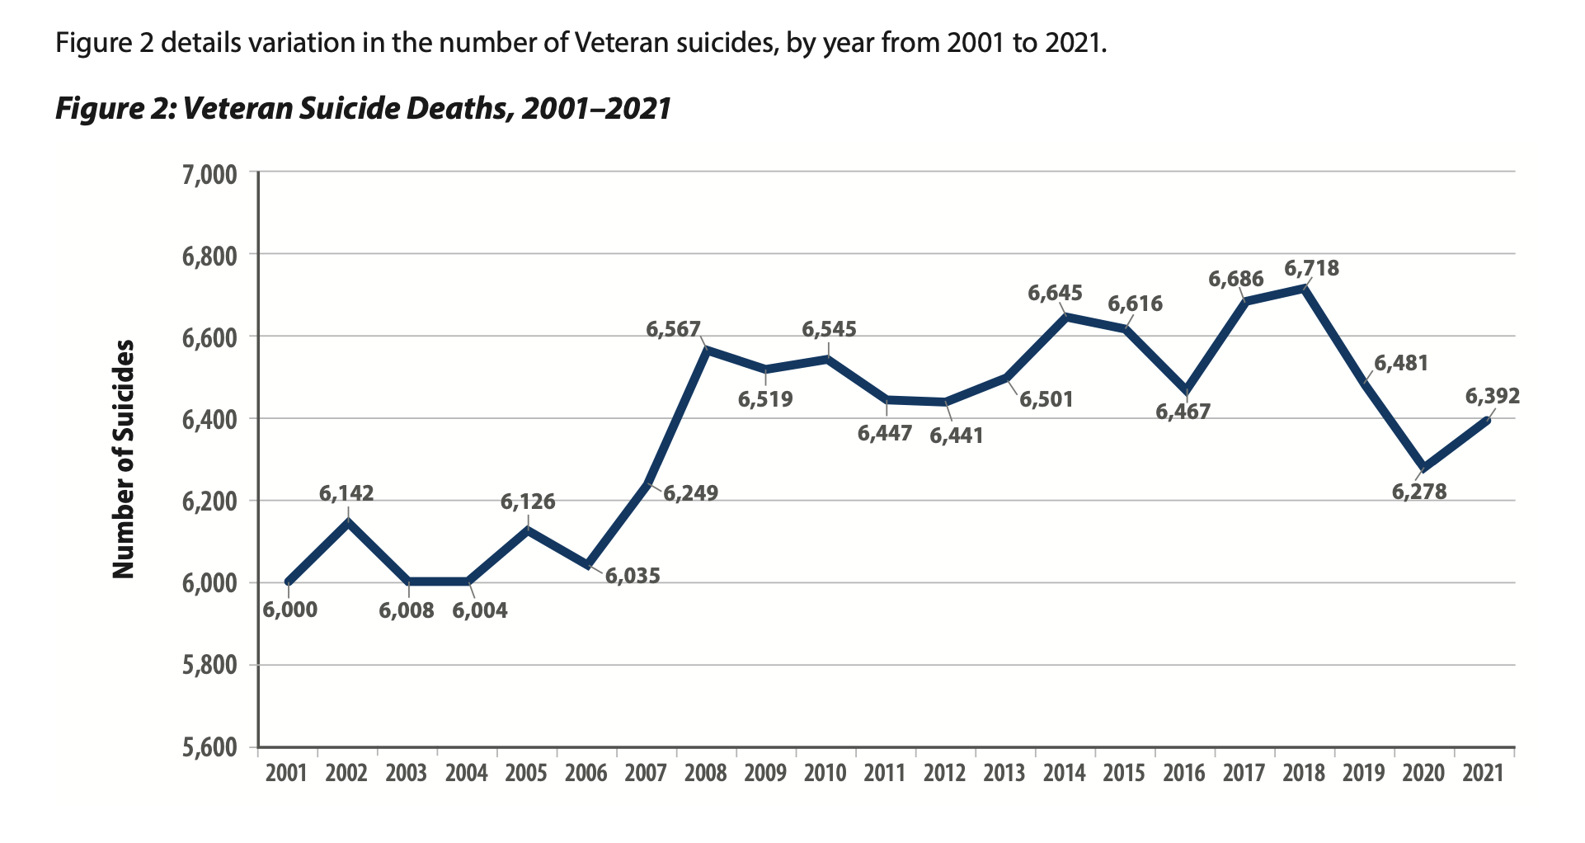

”In 2021, there were on average, 127.2 suicides per day among
U.S. adults, including 17.5 per day among Veterans”
2023 National Veteran Suicide Prevention Annual Report

Slide 3
Volunteers as Gatekeepers
A gatekeeper is usually the first person who can recognize a crisis, and the warning signs, that someone may be contemplating suicide.
You are the eyes & ears of your post!
You will likely be the first person a Veteran will engage with,
upon entering your post.
Gatekeepers can be anyone, but VFW Volunteers are uniquely positioned to recognize Veterans at risk of suicide.
Notes:
This is just one of the reasons it’s so important to be WELCOMING to individuals entering our doors

Slide 4
Efforts to reduce suicide
Prevention - Broad-based efforts to reduce suicide, typically by letting people know that help exists and can be accessed
Assessment - Evaluating risk for someone who presents for mental health care
Intervention - Addressing specific risk when it is known to exist
Notes:
Prevention can be done by anyone! It’s as simple as talking about suicide & having resources available.
Assessments are done by Law Enforcement, and medical or mental health professionals.
Intervention is an immediate situation

Slide 5
Risk Factors
There are many risk factors that may lead someone to thinking about suicide.
All of them lead to core feelings of
ACUTE HOPELESSNESS
LACK OF CONTROL

Slide 6
Risk Factors
Community violence
Historical trauma
Discrimination
Violence victimization and/or perpetration
Stigma associated with help-seeking and mental illness
Easy access to lethal means of suicide among people at risk
Unsafe media portrayals of suicide

Slide 7
Warning Signs of Suicide
Talking about wanting to die
Looking for a way to kill oneself
Talking about feeling hopeless or having no purpose
Talking about feeling trapped or in unbearable pain
Talking about being a burden to others
Acting anxious, agitated, or recklessly
Sleeping too little or too much
Withdrawing or feeling isolated
Showing rage or talking about seeking revenge
Displaying extreme mood swings
Increasing the use of alcohol or drugs

Slide 8
Invitations
Verbal, Physical, Behavioral or Emotional signs of distress that invite help
FOLLOW YOUR GUT!!!
Giving things away
Extreme behavior changes
Decreased hygiene habits
Weight changes
Increased complaining
Withdrawal
“Nothing matters anymore.”
“Now I understand why … did it.”
Hopelessness
Stressful life events
Feelings of extreme loss

Slide 9
What to Do
Do not leave the person alone
Remove any lethal means (firearms, alcohol, drugs, or sharp objects that could be used in a suicide attempt)
Call the Veteran Suicide and Crisis Lifeline by dialing 988, press 1
Call 911 – situationally, let the individual know
If able, take the person to an emergency room, or seek help from
a medical or mental health professional
SAFETY FIRST!
Notes:
The only individuals who can initiate a 5150 in CA are Peace officers, a member of a mobile crisis team, a professional in charge of a county-designated facility, or other mental health professional authorized by the county.

Slide 10
Be Direct
Suicide prevention literature supports using the word “suicide” DIRECTLY and CLEARLY when speaking with someone at risk of suicide.
“Are you thinking about suicide?”

Slide 11
What to Say?
Just be yourself.
We can all relate to the individual emotions that person is feeling, sad, angry, etc., empathize
Try to engage in conversation that will encourage the individual to
  talk about the people, places, or things that are meaningful to them.
  These are the Protective Factors you can work with.
  Remember, they came into the VFW in a crisis, they are likely seeking some kind of comfort or connection.
Notes:
You don’t have to have all the right words. Sometimes just listening is all that’s needed.
“I can understand the feeling of ____, I’ve felt that way before too.” This statement can do wondering in normalizing a situation or feeling.

Slide 12
What to Say?
Ask if they have a plan. If yes:
1. How? When? Where?
2. Are you willing and can it be disabled safely?
Ask if there are they drugs, alcohol or medication involved?
“What have you learned in the past that might help keep you safe right now?”
Notes:
You don’t have to have all the right words. Sometimes just listening is all that’s needed.
“I can understand the feeling of ____, I’ve felt that way before too.” This statement can do wondering in normalizing a situation or feeling.

Slide 13
Protective Factors
Effective coping and problem-solving skills
Reasons for living (for example, family, friends, pets, etc.)
Strong sense of cultural identity
Support from partners, friends, and family
Feeling connected to others
Feeling connected to community and other social institutions
Availability of consistent and high quality physical and behavioral healthcare
Reduced access to lethal means of suicide among people at risk
Cultural, religious, or moral objections to suicide
Notes:
Military is a culture!

Slide 14
Be Mindful
As soon as possible, ensure all proper personnel are contacted.
Do not gossip or discuss the events with anyone
other than the proper authorities or chain of command.
Secure any individual possessions for safekeeping.

Slide 15
Who to Contact
Local police or 911
Your post Commander.
Your post or District Chaplain.
Do not assume you should call their partner!!

Slide 16
Who to Contact
Have a community resource list handy
Local Police
Temecula PD: (951) 696-3000
Murrieta PD: (951) 304-2677
Local Fire: City of Temecula Fire Station 73 - (951) 699-0351
Local Hospital: Temecula Valley Hospital – (951) 331-2200
Riverside County 24/7 Mental Health Urgent Care
Perris: 951-349-4195
Riverside: 951-509-2499
Crisis Lines:
Veteran’s Crisis Line: 988
National Suicide Prevention Line: 800-273-TALK
800-273-8255

Slide 17
If the person
Has intent
Has a plan
Has the means
CALL 911!!!

Slide 18
No One Does More For Veterans!
QUESTIONS?

