Slide 1

VFW Chaplains Training Ethics

Slide 2

Ethics
Ethics: What exactly does that mean?
What are the implications for chaplains?
Applied ethics for chaplains Examples
What will
we learn?

Slide 3

Ethics

Slide 4
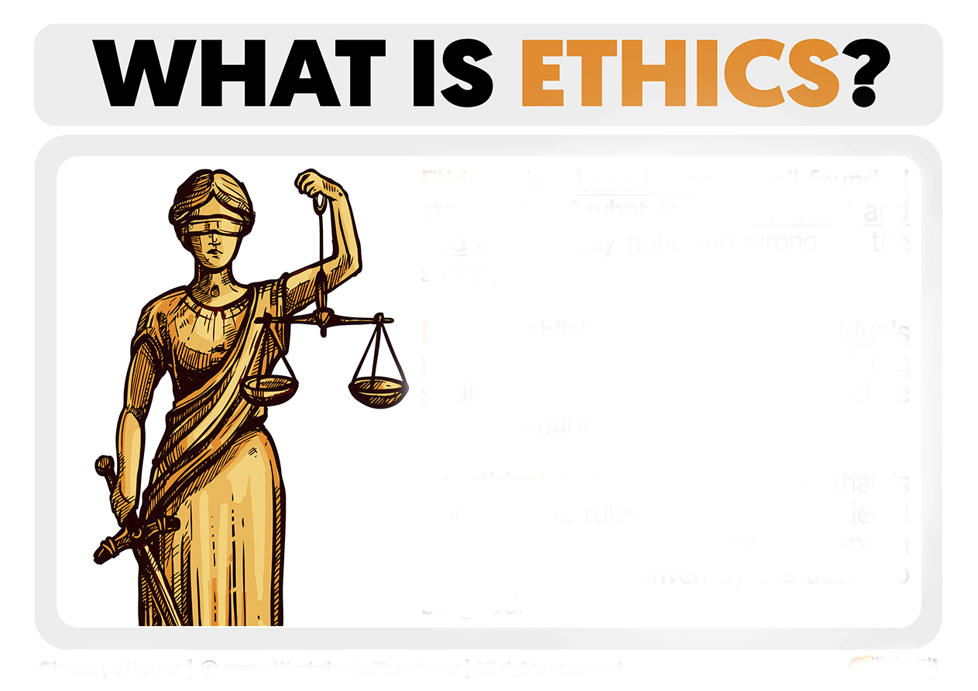
Ethics is a set of moral principles or rules that guide our behavior to determine what is right or wrong.

Slide 5
The purpose of chaplaincy ethics
Accountability:
Public trust:
Safety and well-being:

Slide 6
Core principles
Compassion and empathy:
Integrity and honesty:
Cultural and religious respect:
Professional boundaries:

Slide 7
Key ethical duties
Confidentiality:
Non-proselytizing:
Competence:
Respect for autonomy:
Avoid exploitation:

Slide 8
VFW Chaplain Code of Ethics
1. Chaplains will demonstrate utmost personal and professional integrity: truthfulness, honesty, and compassion to those who they minister to.
2. Chaplains will provide an objective, appropriate, holistic support and a comforting presence.

Slide 9
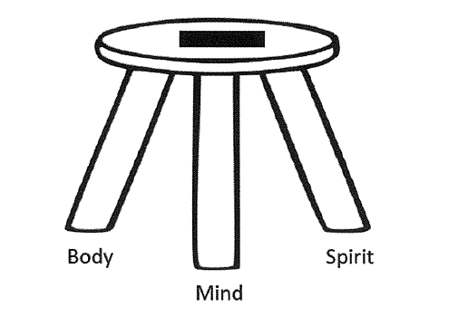

Slide 10
VFW Chaplain Code of Ethics
3. Chaplains will not proselytize. Those who are cared for will be provided freedom from unwanted gifts of religious literature or symbols, evangelistic and sermonizing speech, or forced acceptance of specific moral values and traditions.

Slide 11

4. Chaplains will demonstrate sensitivity to all faith traditions and provide appropriate and sensitive spiritual care to all persons in need, irrespective of their religious or nonreligious identity.
5. Chaplains will not discriminate, with regards to their care, based on sex, age, race, ethnicity, religion, sexual orientation, disabilities, socioeconomic status, or any other factors that would hamper a person’s ability to receive spiritual care.
This Photo by Unknown Author is licensed under CC BY-SA

Slide 12
6. Chaplains will, whenever possible, attempt to locate a spiritual leader within the faith tradition of an affected person, if needed.
7. Out of respect for those who are served, Chaplains will maintain confidentiality.
8. Chaplains recognize their personal and professional limits, know their boundaries and make referrals to professionals with appropriate expertise.
9. Chaplains will do no harm.
This Photo by Unknown Author is licensed under CC BY-SA

Slide 13

Additional Points
Chaplains are volunteers and will take no monetary gifts from those who are served.
Chaplains shall adhere to all applicable Codes of Ethical Standards as prescribed by the VFW

Slide 14
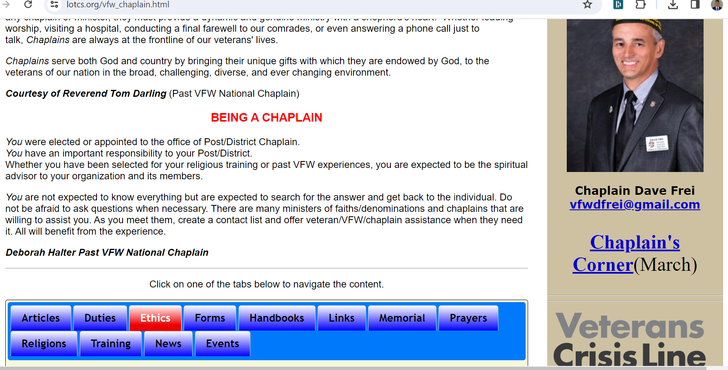

https://lotcs.org/vfw_chaplain.html

Slide 15

VFW Code of Ethics
Also Includes personal conduct
Accountability
Conflict of interest

Slide 16



Slide 17

Questions?

