Slide 1
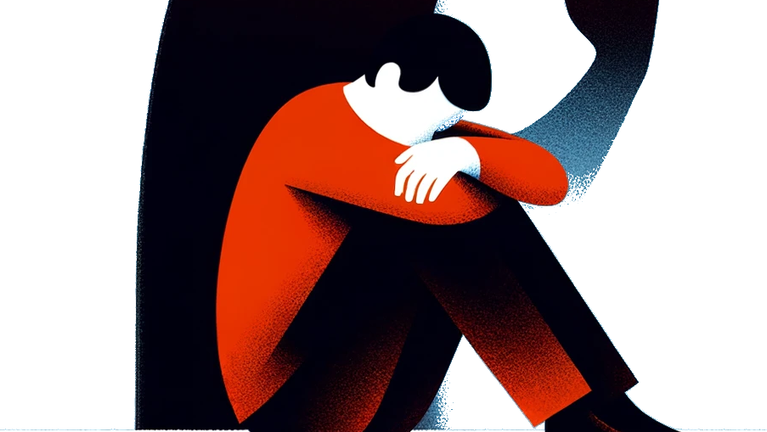
Breaking
The
stigma
The Truth About PTSD and ASD
Amy Alvarez, M.S., LMFT
GySgt/USMC (Ret)

Slide 2
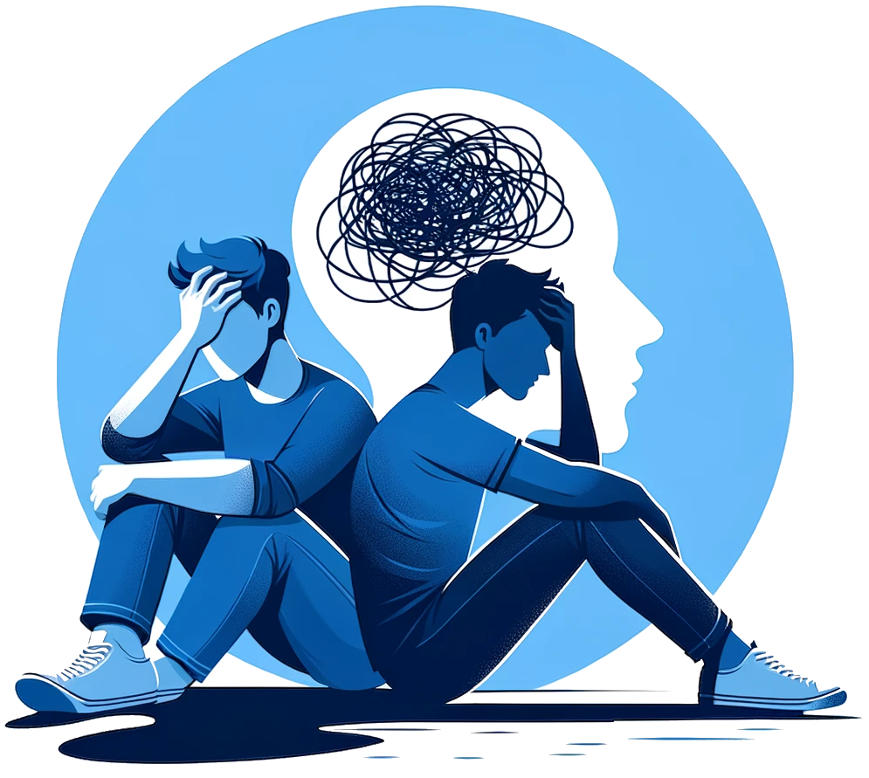

Acute Stress Disorder
A mental health condition occurring in response to a traumatic event, characterized by symptoms lasting from 3 days to 4 weeks post-trauma.

Slide 3
Acute Stress Disorder
Nightmares
Difficulty concentrating and remembering things
Mood swings
Social isolation and withdrawal
Lack of interest in previously enjoyed activities
Easily startled
Edginess and extreme alertness
Change in eating and sleeping patterns
Guilt and shame
Irritability
Anger
Anxiety

Slide 4
Post Traumatic Stress Disorder
A more prolonged reaction to trauma, with symptoms lasting for over a month, potentially lifelong, which may significantly impair an individual’s functioning and quality of life.
*Women more likely to be affected than men
Notes:
FOUR TYPES OF SYMPTOMS
AVOIDANT
INTRUSIVE MEMORIES
CHANGES IN PHYSICAL & EMOTIONAL REACTIONS
NEGATIVE CHANGES IN THINKING AND MOOD.

Slide 5
Post Traumatic Stress Disorder
Flashbacks of the event
Chronic nightmares
Uncontrollable thoughts about the event
Severe anxiety
Re-experiencing symptoms
Avoiding people and places related to the event
Negative thoughts about oneself or others

Slide 6
Post Traumatic Stress Disorder
Difficulty remembering events after the traumatic event
Feeling numb or hopeless
Self-destructive behavior (e.g., alcohol abuse, reckless driving, etc.)
Overwhelming guilt or shame
Always on the lookout for danger
Irritability
Anger or aggressive outbursts

Slide 7

RISK FACTORS
Previous Trauma Exposure
Family History of Mental Health Disorders
Severity and Type of Trauma
Lack of Social Support
Pre-existing Mental Health Conditions
High Levels of Stress and Coping Style
Personal Vulnerability Factors
Early Life Adversity

Slide 8

PROTECTIVE FACTORS
Social Support
Positive Self-Regard
Healthy Coping Strategies
Faith/Spirituality
Optimism
Healthy attachments
Developing Emotional Regulation Skills/Tools

Slide 9
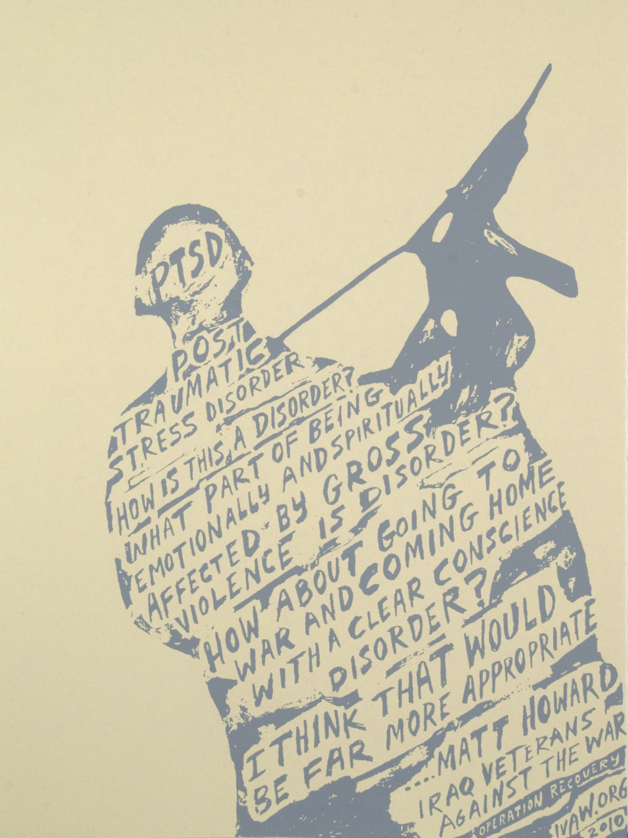
ASD symptoms emerge within 3 days to 1 month after the traumatic event and resolve within that timeframe.
PTSD symptoms can begin immediately after the trauma or be delayed, but they last for more than a month.

Slide 10
Complex PTSD (C-PTSD) results from prolonged and/or repeated trauma and includes additional symptoms beyond typical PTSD.
Comorbid PTSD involves co-occurring mental health conditions, complicating diagnosis and treatment.

Slide 11
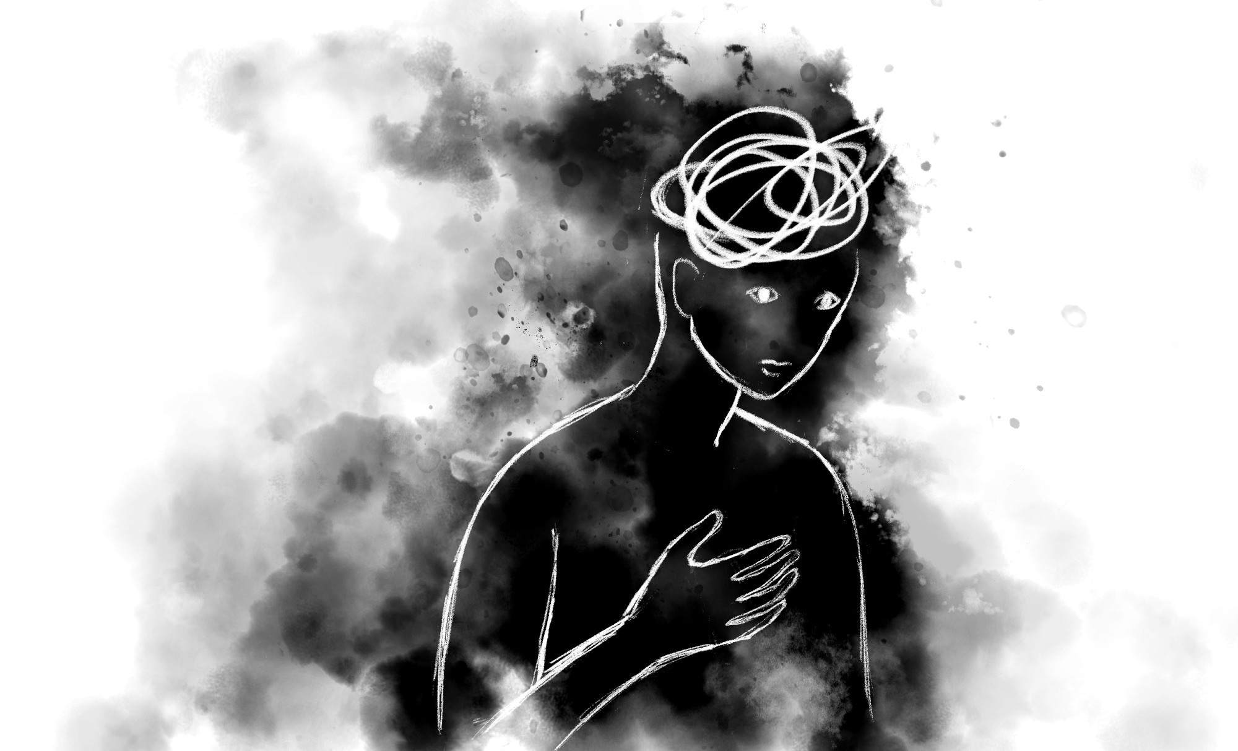
By The Numbers FIRST RESPONDERS
Prevalence: 20–30 % (higher among EMS and firefighters)
Suicide risk: greatly elevated—30–40 % ideation, ~6 % attempts
Comorbid conditions: anxiety, depression, substance misuse
Stigma & treatment gap: over half avoid seeking help
Workplace toll: burnout, sleep issues, productivity loss

Slide 12
By The Numbers VETERANS
Prevalence: 15–18% lifetime; 11–29% for Iraq/Afghanistan veterans
Suicide risk: greatly elevated 20–40%: 18–44 per day
Comorbid conditions: 50–70% with depression or substance-use
Stigma & treatment gap: ~40–50% untreated
Workplace toll: burnout, sleep issues, productivity loss

Slide 13

Understanding the Stigmas
Stigma generally falls into three categories:
Public Stigma – Negative perceptions from society.
Self-Stigma – Internalized shame or guilt from the individual.
Structural Stigma – Systemic barriers or institutional attitudes (e.g. fear of job loss, career impact).
* Among first responders and veterans, these stigmas are especially pervasive due to unique cultural and occupational norms.

Slide 14
“PTSD is a sign of weakness.”
Reality: PTSD is a medical condition resulting from exposure to trauma. It is not a character flaw. * Studies confirm that PTSD can lead to significant changes in brain structure and function*
Why It Persists: Military and emergency service cultures often emphasize toughness, stoicism, and resilience.

Slide 15
“If I talk about my PTSD, I’ll lose my job or be seen as unfit.”
Reality: Seeking help early often preserves long-term ability to work. Many departments now offer confidential services.
Why It Persists: Fear of being sidelined, demoted, or losing firearm privileges in law enforcement or military roles.

Slide 16
“Nobody will understand what I’ve been through.”
Reality: While experiences are unique, many others in similar roles share similar symptoms and reactions. Peer support programs have shown great success.
Why It Persists: Trauma can feel isolating, especially in hierarchical organizations where vulnerability isn’t modeled.

Slide 17
“Real heroes don't need help.”
Reality: Strength lies in acknowledging pain and seeking recovery. Many decorated veterans and leaders now speak openly about their PTSD.
Why It Persists: Cultural and media portrayals often glamorize “invincibility” and suppress acknowledgment of emotional tolls.

Slide 18
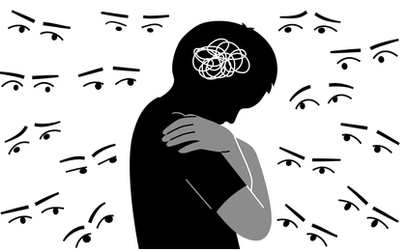
Normalize Mental Health Discussions
Talk more openly about mental health.
Incorporate PTSD education into training and briefings.
Use peer support networks to reinforce that help-seeking is common and encouraged.

Slide 19
Promote Confidentiality
Ensure treatment options are confidential and not punitive.
Separate clinical treatment from disciplinary actions.

Slide 20
Highlight Recovery Stories
Share testimonials of veterans and first responders who have sought help and returned to successful lives and careers.

Slide 21
Change Language
Use terms like “psychological injury” or “moral injury” rather than “mental illness” to align with physical injuries and reduce perceived shame.

Slide 22
Invest in Peer Support and Trauma-Informed Care
Programs like Critical Incident Stress Management (CISM) and peer-led interventions can bridge the gap between avoidance and professional help.
Create safe spaces to decompress after traumatic calls or deployments.

Slide 23
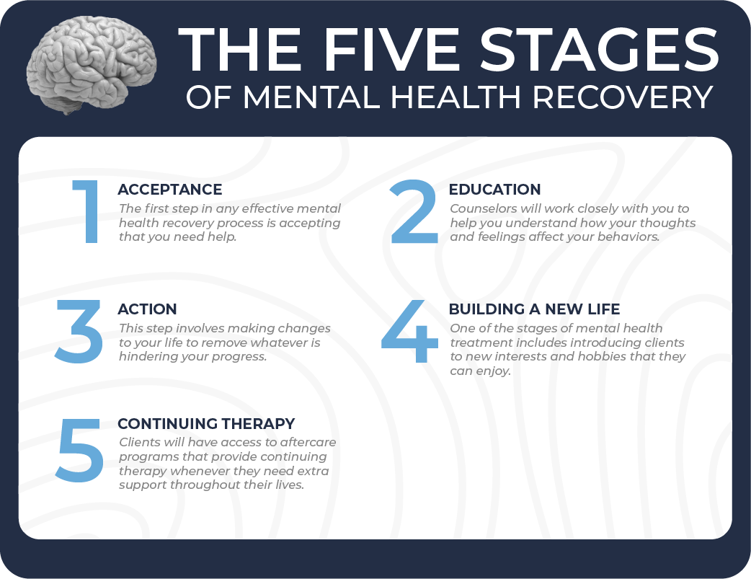
RECOVERY IS POSSIBLE!!!

Slide 24
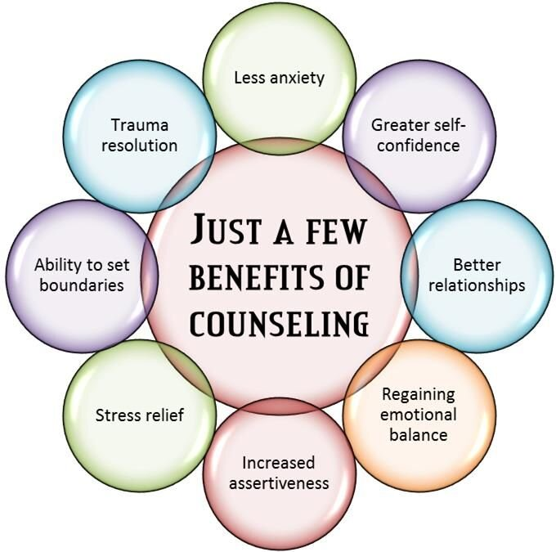
TREATMENT OPTIONS
Cognitive Processing Therapy (CPT) Helps individuals identify and change negative thoughts and beliefs related to the trauma.
Eye Movement and Desensitization Therapy (EMDR) - Helps individuals process traumatic memories while focusing on specific external stimuli.
Prolonged Exposure Therapy (PET) - Gradually exposes individuals to trauma-related memories, feelings, and situations to reduce avoidance and fear.

Slide 25
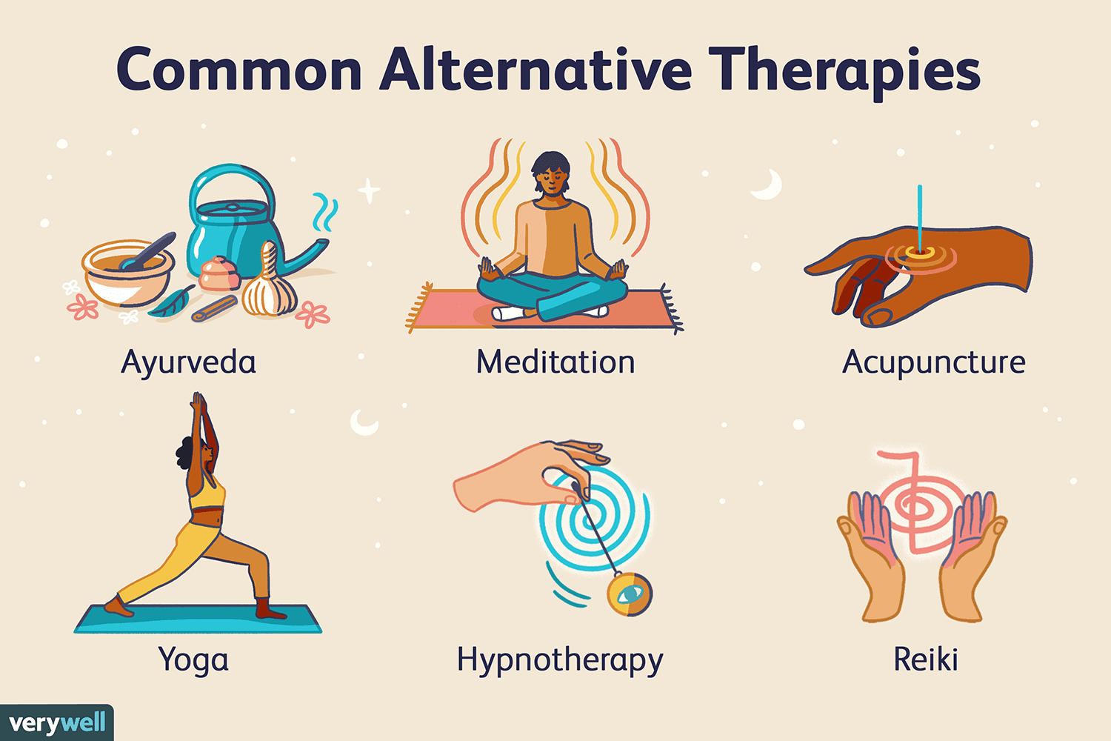
ALTERNATIVE TREATMENT OPTIONS
Medications
Spiritual/Religious Practices
Meditation/Mindfulness
Yoga
Tai Chi & Qigong
Deep Breathing Exercises
Acupuncture
Music Therapy
Energy Psychology (Emotional Freedom Technique (EFT) and Thought Field Therapy (TFT))
Healing from PTSD naturally takes dedication and endurance

Slide 26
Final Thought
PTSD is not a personal failure—it’s a human response to extreme stress. Breaking the stigma means creating environments where first responders and veterans feel safe, respected, and empowered to heal.

Slide 27

https://www.psychologytoday.com/us

Slide 28
11 10 Therapy:
https://11-10therapy.com/services/#:~:text=Insurance%20Providers,in%2Dnetwork%20providers%20for%20therapy.
Healing Our Own:
https://healingourown.org/getting-help#:~:text=Public%20Safety%20Professionals%20Retreat%2D%2D,in%20a%20safe%20confidential%20environment.

Slide 29
California Fire Chiefs Association
https://www.calchiefs.org/page/FirstResponderBehavioralHealthandWellness#:~:text=The%20CFCA%20Foundation%2C%20led%20by,approach%20across%20California's%20fire%20service.
FireScope California:
https://firescope.caloes.ca.gov/behavioral-health#:~:text=Firefighters%20and%20first%2Dresponders%20are,into%20the%20Incident%20Command%20System.

Slide 30
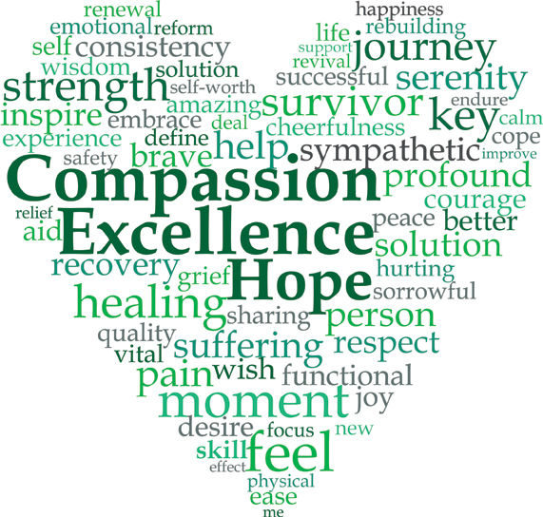
RESOURCES information
https://news.vt.edu/articles/2025/03/cals-jarome-bystander-ptsd.html
https://www.healthline.com/health/mental-health/ptsd-brain-vs-normal-brain
https://pmc.ncbi.nlm.nih.gov/articles/PMC3181836/

Slide 31
