Slide 1

Chaplains
Basic Training

Slide 2
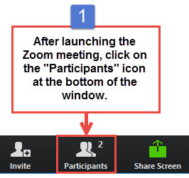
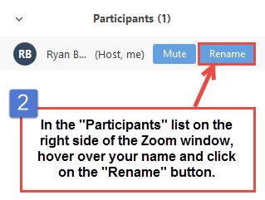
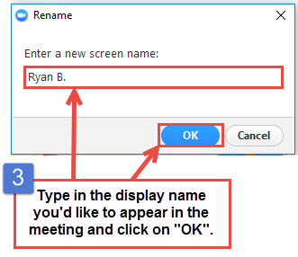
Name and state and your organization if other than VFW comrade
How to rename yourself in Zoom
Notes:
Before we start need correct info on each of you for records. Please hold questions and comments till the end unless an important clarification is needed., This is because we are recording the presentation

Slide 3

Topics
Org structure: chaplains
Your role & duties
Available training & resources for Chaplains
Chaplain reports
Notes:
This will go over quite a few things, but just the highlights. Individual classes cover each of the many topics more in depth. This is an introductory overview. The goal is to help you determine what you need to learn and focus on

Slide 4
Organizational Structure
National Chaplain
Conference Chaplains
State Chaplains
District Chaplains
Post Chaplains
Notes:
The National Chaplain provides leadership and sets the overarching vision for the VFW Chaplaincy.
Working closely with the four Conference Chaplains, the National Chaplain ensures alignment across all levels—state, district, and post—guiding chaplains in fulfilling their mission of ministering to veterans and their families.

Slide 5
Organizational Structure
Elected at National convention:
Nominated by conference
National Chaplain
Conference Chaplains
State Chaplains
District Chaplains
Post Chaplains
Elected by Conference
Elected at Dept Convention
Appointed by District Commander 1 year
Appointed by post Commander ted for 1 year
Develop Assistants
Each is elected /appointed for one year term

Slide 6
Four Conferences
Eastern
Big 10
Dept.
of Europe
Western
Dept.
of Pacific Areas
Southern
Notes:
The rotation is Eastern, Southern, Big 10, and Western

Slide 7

Spirituality in America
89% of Americans believe in a god or universal spirit
Only 50% of these believers regularly attend any religions services
Notes:
Some preliminary background about our military community

Slide 8
“Demographic and Military Service Characteristics of Military Families” National Institutes for Health
Christian faith (69%), with the most common denominational preferences being Catholic (20%) and Baptist (14%)
Non-Christian reported affiliations that made up 1 percent or more of the force were
Humanist (4%),
Pagan (1%)
Jewish (1%)
https://www.ncbi.nlm.nih.gov/books/NBK547615/#:~:text=The%20majority%20of%20military%20personnel,2) accessed 8/13/2023
Notes:
This gives you snapshot of our veteran’s stated religious views

Slide 9

Use your resources!
Many faiths and
Worldviews
Notes:
Religious leaders from the individual faith group, and members in your VFW family that may be well versed in a particular group

Slide 10


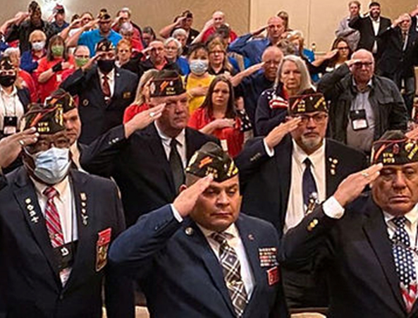

Use your resources!
Many faiths and
Worldviews
Use your Resources
Notes:
Funeral need in N California Legion did service

Slide 11
The Work of the Chaplain
the Chaplain nurtures the living.
the Chaplain cares for the dying.
the Chaplain honors the dead.
Notes:
We minster to people at all phases of life

Slide 12

WHAT THE CHAPLAIN PROVIDES
1. SPIRITUAL GUIDANCE:
2. ASSISTANCE IN EMERGENCY SITUATIONS:
3. CONDUCTING/ASSISTING AT FUNERALS:
4. COUNSELING:
5. VISITATION:
6. ATTENDING FUNCTIONS:
Notes:
These are each their own topics that get covered in monthly training or you can view yourself in the training library

Slide 13
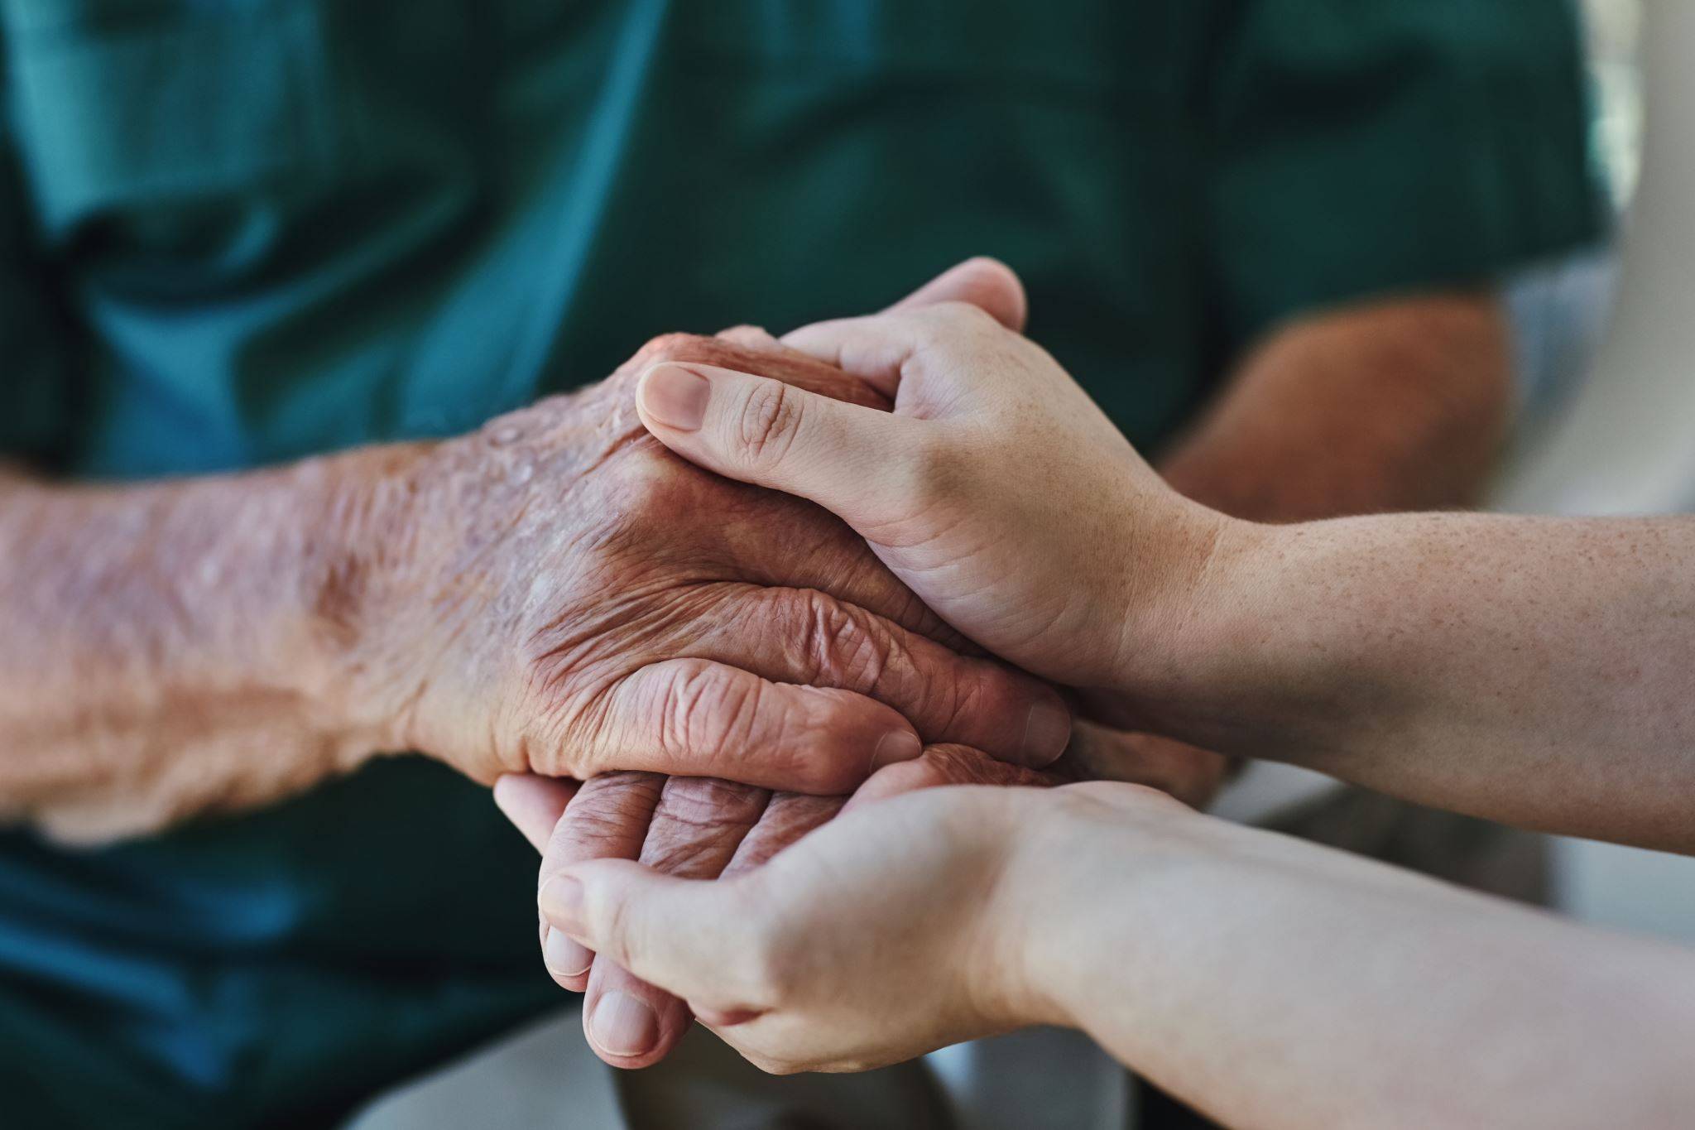
How we can serve our members
Chaplains can help fill that gap for the unchurched.
Broach the topic of spirituality
Be available and a good listener
You don’t have to be an expert; you just have to care.
How to achieve this: Be a friend! We all know how to do this
Notes:
Listen more than you speak and make it client centered.

Slide 14

Notes:
You minister by being present, available, and approachable

Slide 15
How to be approachable
Don’t have an agenda
Listen more than you speak
Non judgmental
Initiate conversations and get to know people
Notes:
Having agenda includes evangelizing and being seen as a bible thumper. That will label you as someone to possible avoid.

Slide 16
QUALIFICATIONS OF CHAPLAINS
A VFW Chaplain candidate is not required to be a "professional” clergy person or have formal seminary training. . (Most Post/Auxiliary Chaplains are not.) The qualifications are simple yet important:
1- A willingness to serve the office.
2- A sense of spiritual maturity.
3- Committed to providing a Chaplain’s ministry.
4- A caring person.
5- A desire to help people.
6- The ability to keep things confidential.(Extremely important.)
7- Willing to be neutral and objective when settling disputes.
8- Chaplains should be proud of their office and determined to do a good job.

Slide 17
What’s NOT required
Ordination
Seminary (or similar)degree
Certification

Slide 18
New Chaplain Learning Goals
Familiarize yourself with the Chaplains Handbook
Familiarize yourself with VFW National Chaplains Website
Attend monthly chaplains training
Notes:
If you are new or haven’t done this et make this a learning priority. Address each

Slide 19
Equipping Yourself as Chaplain
Communicate your needs and interests
Network with other chaplains
Ask for help
Take advantage of any training available
Share all resources with other Chaplains
Notes:
By all means reach our to others. Feel free to make suggestions on future training topics or articles

Slide 20


Slide 21
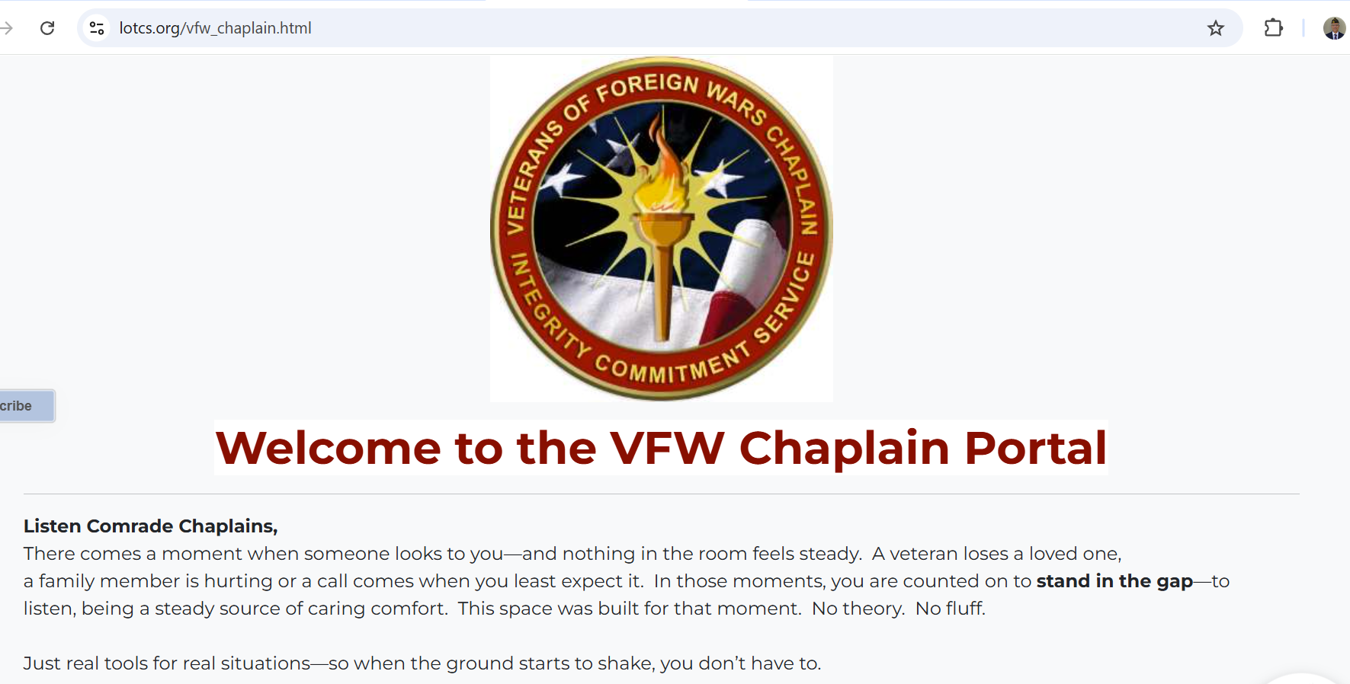
https://lotcs.org/vfw_chaplain.html
Or just search for “VFW National chaplain”

Slide 22
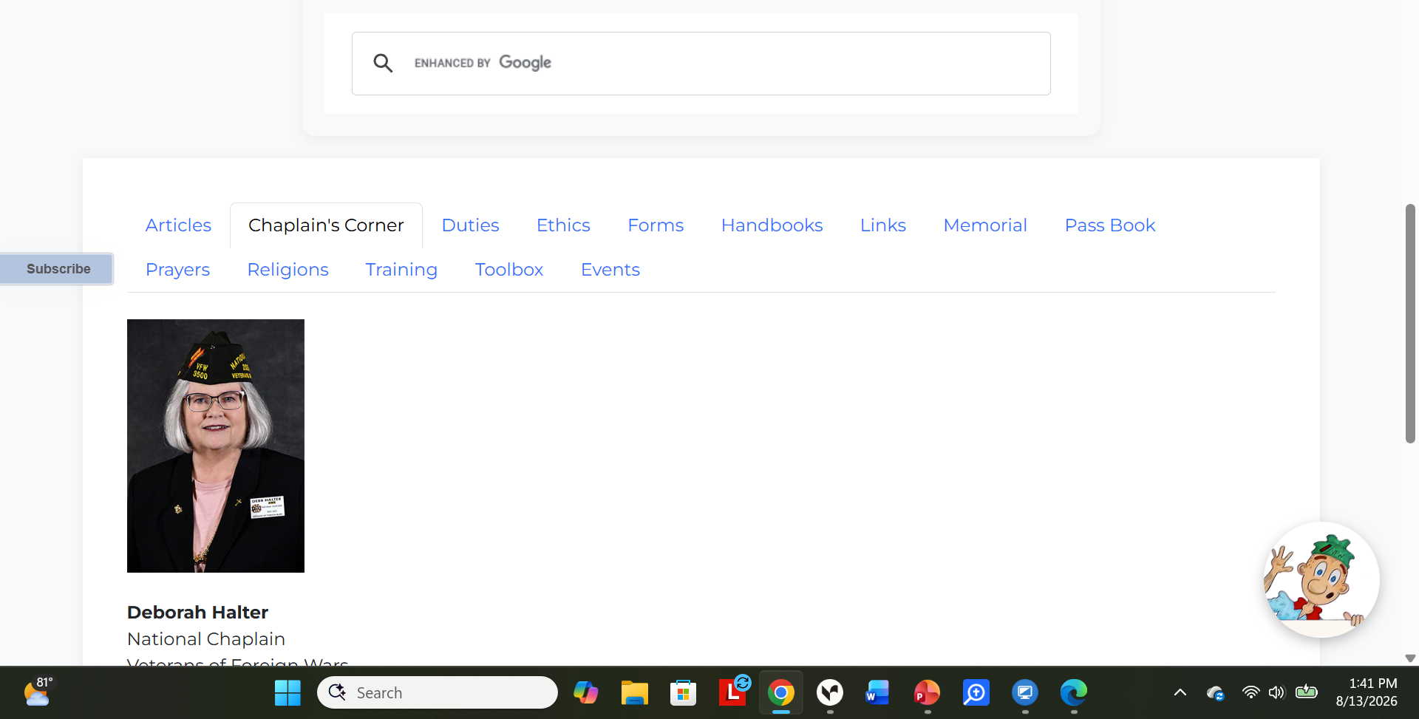
Notes:
Take a look at the tabs at the bottom of the main page. Lots of important links. Browse, get familiar with all the resources available.

Slide 23
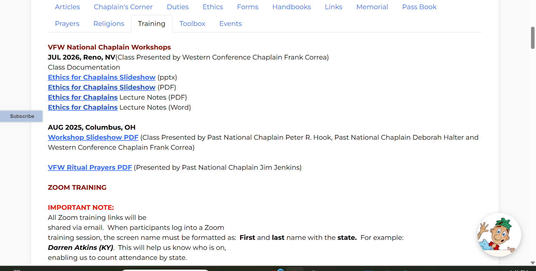

Notes:
For example the training tab

Slide 24
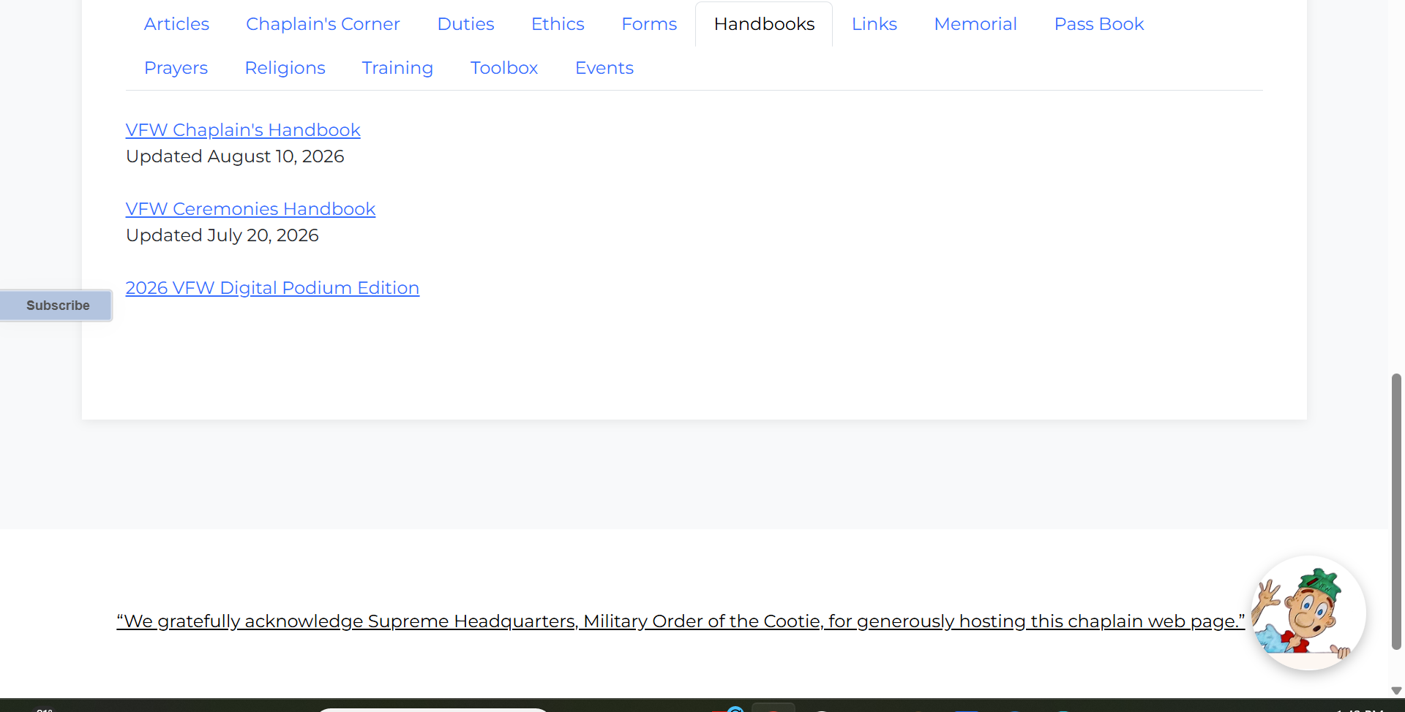


Slide 25

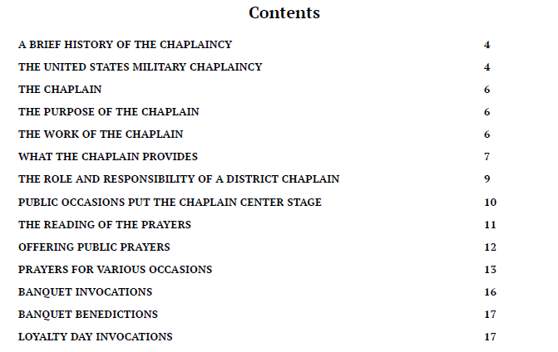

Slide 26

Chaplain Learning opportunities

Slide 27

VFW Chaplains
National Chaplains
Training meetings
3rd Thursday of most months
7:30 p.m. CST monthly ZOOM training
Contact to be on notification list
peterhook@verizon.net
Notes:
Our monthly continuing education; rotating subjects and speakers. Links not posted publically

Slide 28
Previous training classes
Introduction to VFW Chaplaincy
Praying in the VFW Environment
Lessons learned as a Chaplain,
lessons learned.
Dealing with Grief
Suicide Awareness
PTSD
Ethics

Slide 29
Previous training classes
VFW Rituals,
Confidentiality issues
Active listening skills, Draping the Charter
Basic introduction to different religions and faith groups.
Hospital visits
Dashboard reporting, the importance of crediting chaplain work

Slide 30


Great Introductory book
On Chaplaincy Basics

Slide 31
Chaplaincy Bibliography
Baily, Joseph. The Last Thing We Talk About
Becker, Arthur, H. The Compassionate Visitor; Resources for Ministering to the Ill
Biddle, Perry, H. A hospital Visitation Manual
Cheston, Shanon E. (Ed.) Essentials For Chaplains
Dayringer, Richard (Ed.) Pastor and Patient; A Handbook for Clergy Who Visit the Sick
Kirkwood, Neville, A. Pastoral Care in Hospitals
Kirkwood, Neville, A. A Hospital Handbook on Multiculturalism and Religion.
Bible Promise Book. The

Slide 32
Chaplaincy Bibliography
Linn, Erin. I know Just How You Feel: avoiding the clichés of grief
Reimer, Lawrence. The Hospital Handbook: A Practical Guide to Hospital Visitation.
Wiersbe, Warren. Comforting the Bereaved
Wiersbe, Warren. When Life Falls Apart
Wright H. Norman. Crisis Counseling
Yancy, Philip. Where is God When it Hurts
Bible Promise Book.
Keith Evans, Essential Chaplain Skill Sets: Discovering Effective Ways to Provide Excellent Spiritual Care

Slide 33


Notes:
Two helpful gifts to those you minister too. And a great tool for you!

Slide 34





Many Resources on world religions
Notes:
Forst one got cut off. “pocket guide to world religions

Slide 35



Notes:
Some books are not “how to books” but historical and inspirational . I find these very valuable

Slide 36

A Basic Introduction on informal counseling
Suggested reading
Excellent and short easy read

Slide 37
Our greatest resource is each other

Slide 38

Prayers
Changes to Podium Edition
Options: a. use verbatim,
b. modify prayers
c. write your own
3. Always be prepared
4. Shorter is better
Notes:
Sources: podium edition, VFW Chaplains Handbook

Slide 39
Prayers
Meeting invocations and benedictions
Memorials
Graveside services
Public meetings
Banquet invocations
Holiday events
Prayers for the sick

Slide 40
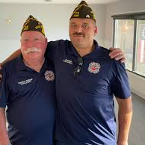
Visitation Principles
Client centered
Listen
Look professional
Be a friend!

Slide 41


Know your limitations: time, health etc
Set limits

Slide 42
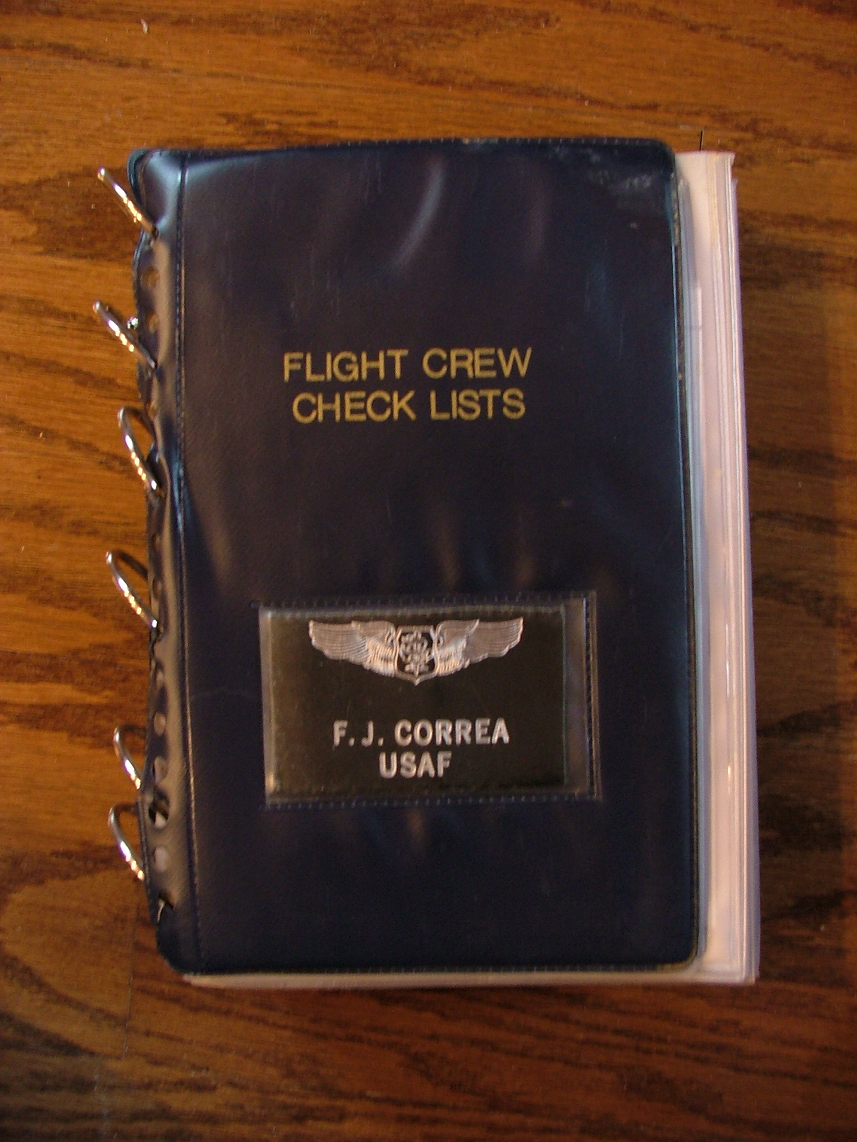
Emergency Checklist
RAPID DECOMPRESSION
1. OXYGEN - ON, 100%
2. CREWMEMBER SECURED AS REQUIRED
3. PATIENTS AND PASSENGERS ASSIST AS REQUIRED
Put on your own oxygen mask first!
Notes:
Don your own O2 first. Why?

Slide 43

Chaplain self care

Slide 44



Slide 45

Questions?

Slide 46
Contact information
Frank J. Correa
fcorreavfw@gmail.com

