Slide 1

VFW Chaplains Training
Ethics

Slide 2
Ethics

Slide 3
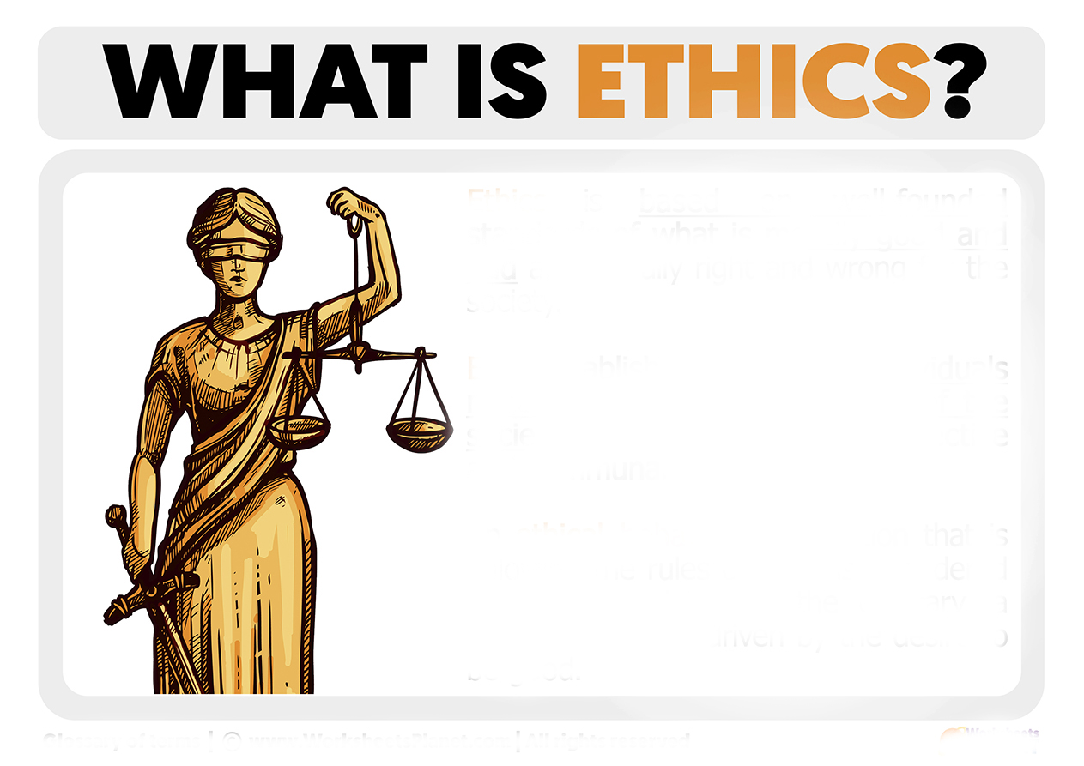
Ethics is a set of moral principles or rules that guide our behavior to determine what is right or wrong.

Slide 4
The purpose of chaplaincy ethics
Accountability:
Public trust:
Safety and well-being:

Slide 5
Key ethical duties
Confidentiality:
Non-proselytizing:
Competence:
Respect for autonomy:
Avoid exploitation:

Slide 6
VFW Chaplain Code of Ethics
1. Chaplains will demonstrate utmost personal and professional integrity: truthfulness, honesty, and compassion to those who they minister to.
2. Chaplains will provide an objective, appropriate, holistic support and a comforting presence.
Notes:
On our webpage

Slide 7
VFW Chaplain Code of Ethics
3. Chaplains will not proselytize. Those who are cared for will be provided freedom from unwanted gifts of religious literature or symbols, evangelistic and sermonizing speech, or forced acceptance of specific moral values and traditions.

Slide 8

4. Chaplains will demonstrate sensitivity to all faith traditions and provide appropriate and sensitive spiritual care to all persons in need, irrespective of their religious or nonreligious identity.
5. Chaplains will not discriminate, with regards to their care, based on sex, age, race, ethnicity, religion, sexual orientation, disabilities, socioeconomic status, or any other factors that would hamper a person’s ability to receive spiritual care.
This Photo by Unknown Author is licensed under CC BY-SA

Slide 9
6. Chaplains will, whenever possible, attempt to locate a spiritual leader within the faith tradition of an affected person, if needed.
7. Out of respect for those who are served, Chaplains will maintain confidentiality.
8. Chaplains recognize their personal and professional limits, know their boundaries and make referrals to professionals with appropriate expertise.
9. Chaplains will do no harm.
This Photo by Unknown Author is licensed under CC BY-SA

Slide 10
10. Chaplains are volunteers and will take no monetary gifts from those who are served.
11. Chaplains shall adhere to all applicable Codes of Ethical Standards as prescribed by the VFW
This Photo by Unknown Author is licensed under CC BY-SA

Slide 11
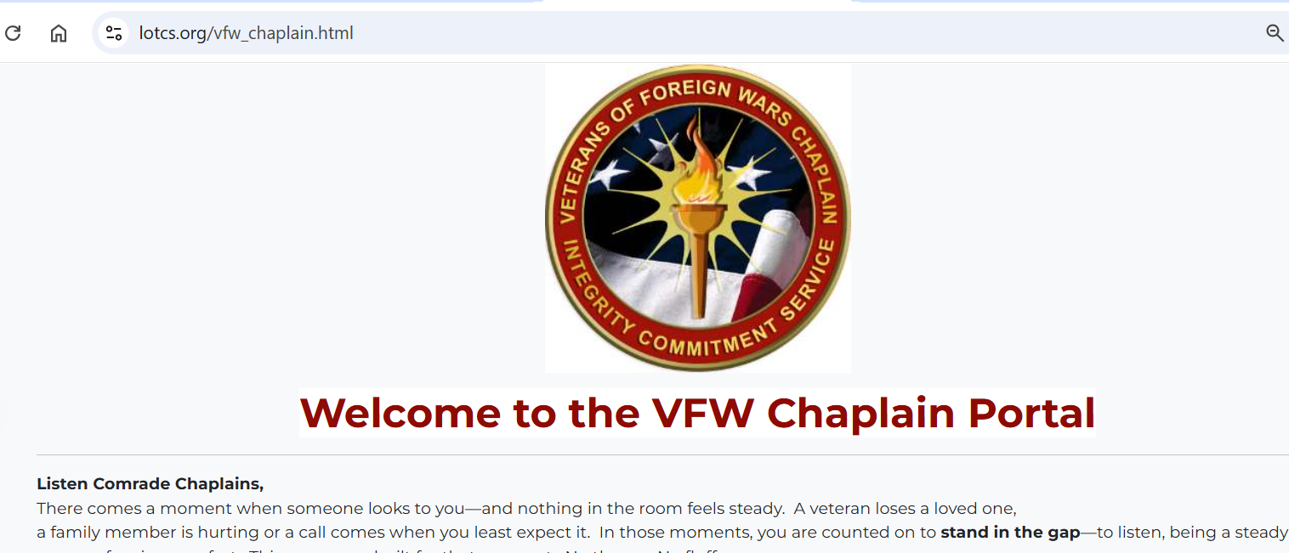
https://lotcs.org/vfw_chaplain.html

Slide 12
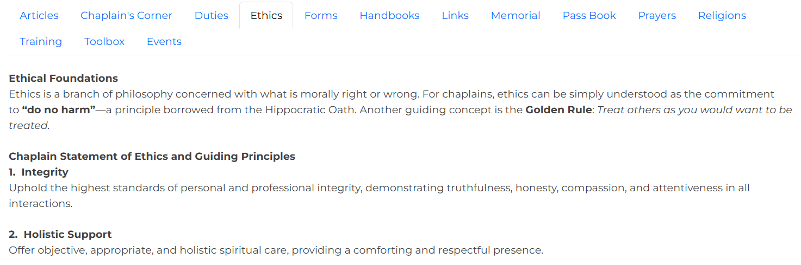

Notes:
On our national chaplain website

Slide 13

VFW Code of Ethics
Also Includes
personal conduct
Accountability
Conflict of interest
Notes:
Department of CA site and Code of Ethics

Slide 14

Additional Points
Avoid or correct any conflicts of interest or appearance of conflicting interest.
Understand the limits of your individual expertise and make referrals to other professionals when appropriate.
Do not directly or by implication claim professional qualifications that exceed actual qualifications. Represent yourself honestly.
Promote good relationships with your fellow chaplains.
Never forget we each represent the VFW, the chaplaincy.

Slide 15


Slide 16
Why Chaplains Must Avoid Taking Sides
Maintaining Neutrality
Preventing Triangulation
Protecting the Care Environment

Slide 17



Slide 18

Questions?

