Slide 1

Community Service Best Practices
VFW Guide to Serving Our Communities

Slide 2

Why Community Service Matters
• Builds trust: “People don’t care how much you know until they know how much you care.”
• Strengthens community and Post reputation
• Benefits include:
- New members
- Effective fundraising
- Greater participation
- Goodwill & recognition

Slide 3
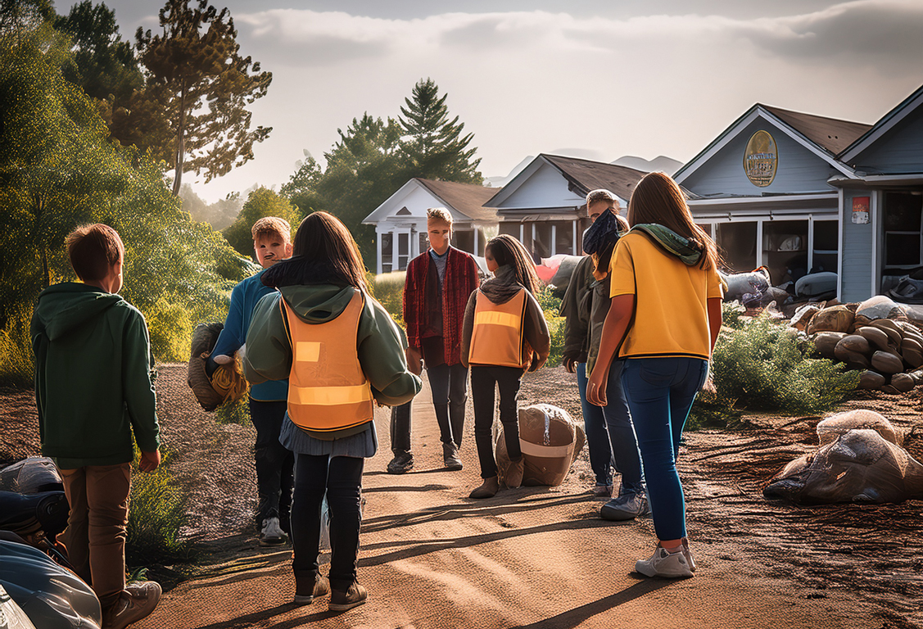
Definition of Community Service
• “Any human act serving the common good; in the interest of the community.”
• Service performed for the public or its institutions
• Since 1899, a cornerstone of the VFW

Slide 4

Reporting Community Service
• Must be done as a representative of the VFW
• Service must benefit the community beyond the Post
• Not counted:
- Post maintenance, dinners, bingo, Poppy drives, church service
• Report events year-round (July 1 – June 30)

Slide 5

Value of Service
• Volunteer Hour (2023): $31.80
• Charitable Mileage Rate: $0.14/mile
• Total Impact Formula:
Money Spent + Volunteer Hours + Mileage = Event Impact

Slide 6
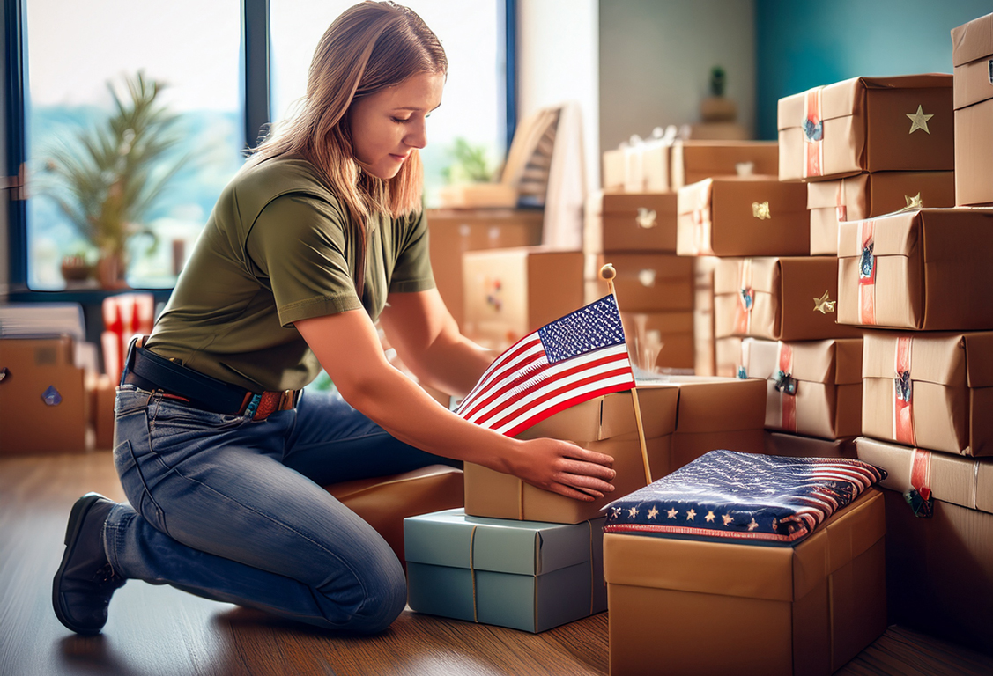

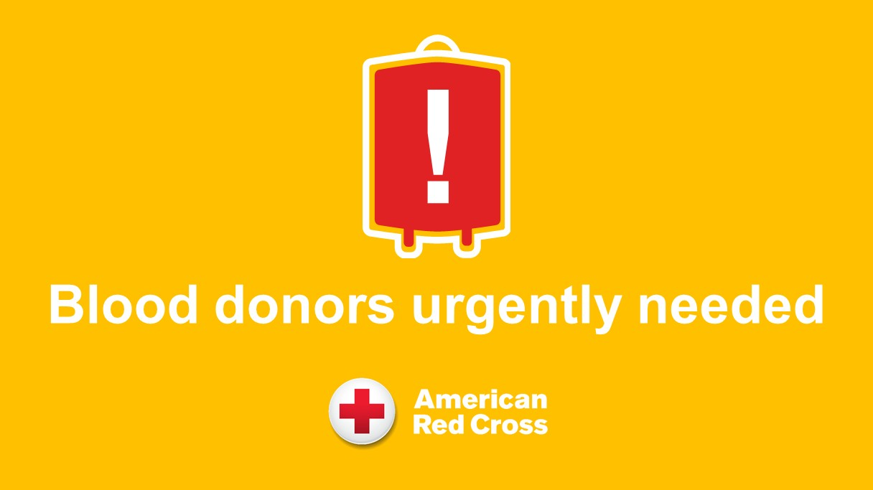
Examples of Good Community Service
• Helping veterans in the community
• Scholarships & youth team sponsorships
• Blood drives & food bank support
• VA hospital and nursing home visits
• Building ramps for disabled veterans
• Job fairs & voter registration
• Disaster relief & community clean-up

Slide 7
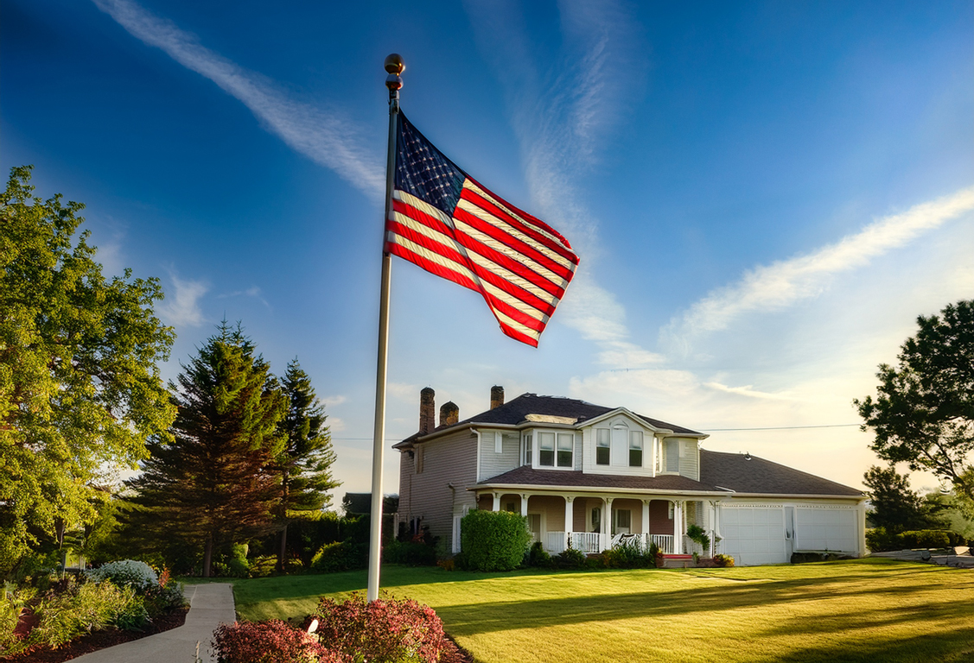
Examples of Non-Qualified Service
• Flying the U.S. or POW flag
• Post dinners or bingo nights
• Paid Service Officer work
• Personal volunteering (not through VFW)
• Buddy Poppy drives
• Membership drives
• Anything that only benefits the Post

Slide 8

Summing it up…
Community Service = Visibility, Impact, Growth
Serve with pride, report with accuracy, and strengthen both the VFW and your community.

