Slide 1

Chaplain’s Training in the VFW and Auxiliary: Building Spiritual Leadership and Support
Exploring chaplains’ roles and training in veteran support
Notes:
---
This presentation covers the vital role of chaplains within the Veterans of Foreign Wars (VFW) and Auxiliary. We will explore their responsibilities, training components, and how they support members and families through spiritual leadership.

Slide 2

Agenda Overview
Overview of the VFW and Auxiliary Chaplain Roles
Supporting Members and Families
VFW Components of Chaplain’s Training
Collaboration and Continuing Education
Notes:
---
We will discuss the roles and responsibilities of VFW and Auxiliary chaplains, core training components, ways they support members and families, and collaboration and continuing education opportunities to enhance their effectiveness.
Image source: Microsoft 365 content library

Slide 3
Overview of the VFW and Auxiliary Chaplain Roles
Notes:
Understanding the purpose and key responsibilities of chaplains within the VFW and Auxiliary is essential. This section highlights their importance as spiritual leaders and support figures within the organization.

Slide 4
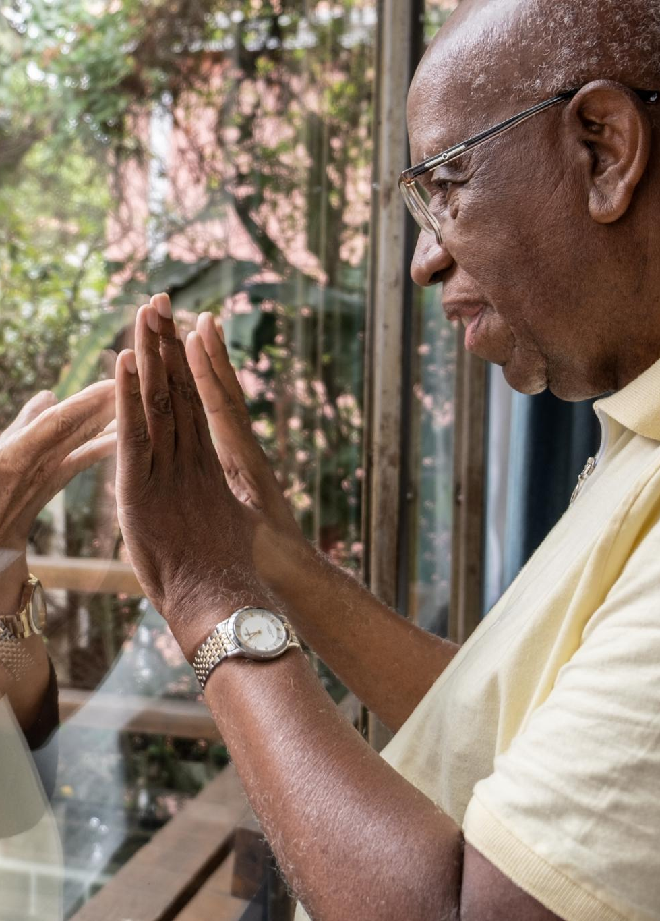
Purpose and Responsibilities of a Chaplain
Spiritual Leadership
  Chaplains offer spiritual support to individuals within the community or organization.
Conducting Ceremonies
  They perform ceremonies that mark important life events, fostering community and tradition. ie. Prayers during meetings and before meals, memorial services, swearing in of officers and other services as needed.
Ethical and Moral Support
  Chaplains uphold moral and ethical standards by offering wise counsel and support in difficult times. We are advisors to the Commander/President. We assist them not tell them what to do!
Notes:
---
Chaplains serve as spiritual leaders, providing guidance, comfort, and support to members. They conduct ceremonies, offer counseling, and uphold the moral and ethical standards of the organization.
Image source: Microsoft 365 content library

Slide 5
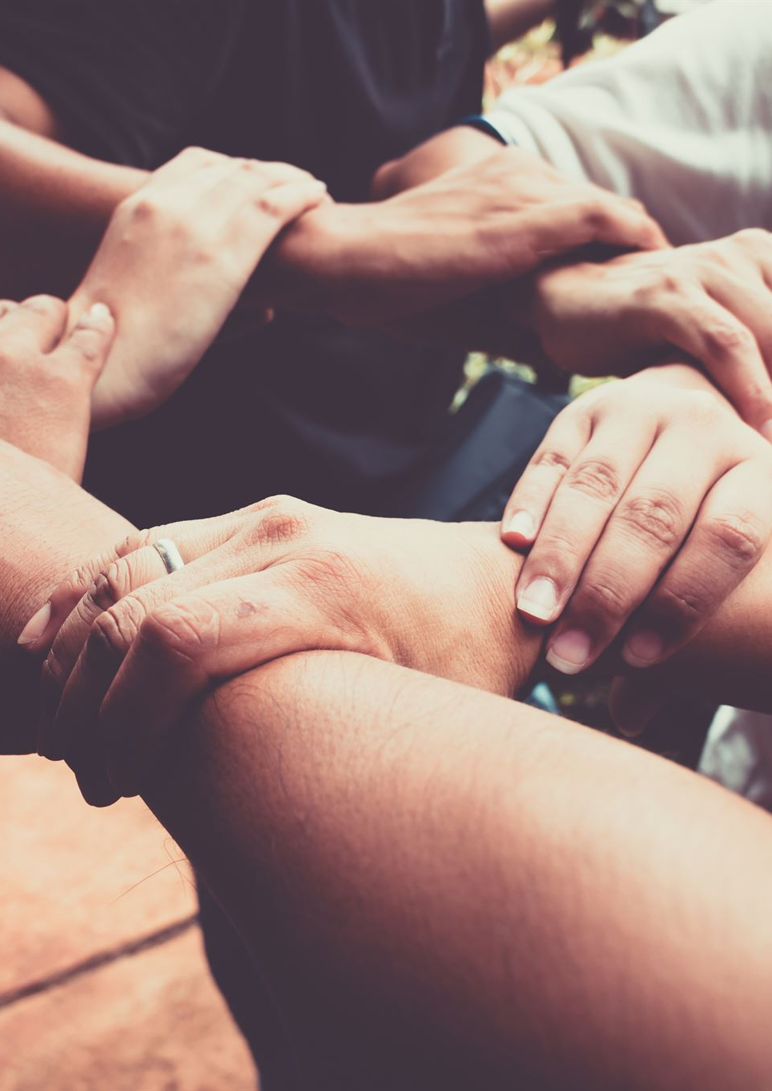
Importance of the Chaplain Within the Organization
Spiritual Well-being Support
  Chaplains foster spiritual well-being, providing comfort and guidance to members of the organization.
Morale Strengthening
  Their presence boosts morale, helping members feel valued and supported during challenges.
Trusted Resource in Need
  Chaplains serve as a trusted resource, offering care and counseling in times of personal or collective need.
Notes:
---
Chaplains play a critical role in fostering spiritual well-being and unity among members. Their presence helps strengthen morale and provides a trusted resource during times of need.
Image source: Microsoft 365 content library

Slide 6
Core Components of Chaplain’s Training
Notes:
Effective chaplain training covers essential skills, spiritual guidance, ethical considerations, and ceremonial duties to prepare chaplains for their multifaceted role.

Slide 7

Essential Skills and Knowledge Areas
Communication Skills
  Effective communication is vital for clear understanding and collaboration among team members.
Conflict Resolution
  Training in conflict resolution helps manage and resolve disagreements constructively.
Cultural Sensitivity
  Cultural sensitivity training fosters respect and understanding of diverse backgrounds.
Military Traditions
  Understanding military traditions is key to effectively supporting veterans and their family members.
Notes:
---
Training includes communication skills, conflict resolution, cultural sensitivity, and understanding military traditions to effectively support diverse members.
Image source: Microsoft 365 content library

Slide 8

Spiritual Guidance and Ethical Considerations
Non-denominational Support
  Chaplains provide spiritual support that respects diverse religious beliefs and backgrounds. We take care of everyone as best we can. We know to refer to outside ministers if necessary. We are not expected to know everything about all religions but to seek those that know that religion so they can help that individual.
Confidentiality Importance
  Maintaining confidentiality is essential to creating a trusting environment for spiritual guidance. Exception: when a person self harms or when a child is in danger in anyway.
Ethical Principles
  Ethical guidelines ensure chaplains respect individual dignity and provide unbiased support.
Notes:
---
Chaplains learn to provide non-denominational spiritual support while respecting individual beliefs, maintaining confidentiality, and adhering to ethical principles.
Image source: Microsoft 365 content library

Slide 9

Ceremonial and Ritual Responsibilities
Conducting Official Ceremonies
  Chaplains lead official ceremonies that honor members’ service and sacrifice with dignity and respect.
Maintaining Tradition and Solemnity
  Rituals conducted by chaplains preserve tradition and create a solemn atmosphere during memorials.
  These rituals are written in our ritual book that is printed out yearly and can be purchase though the National Organization sometimes referred to as the podium edition. The commander is responsible for having a new one every year.
Notes:
---
Chaplains conduct official ceremonies, memorials, and rituals that honor members' service and sacrifice, maintaining tradition and solemnity.
Image source: Microsoft 365 content library

Slide 10
Supporting Members and Families
Notes:
Chaplains offer critical support to members and families, especially during difficult times, providing comfort, counseling, and connecting them to community resources.

Slide 11
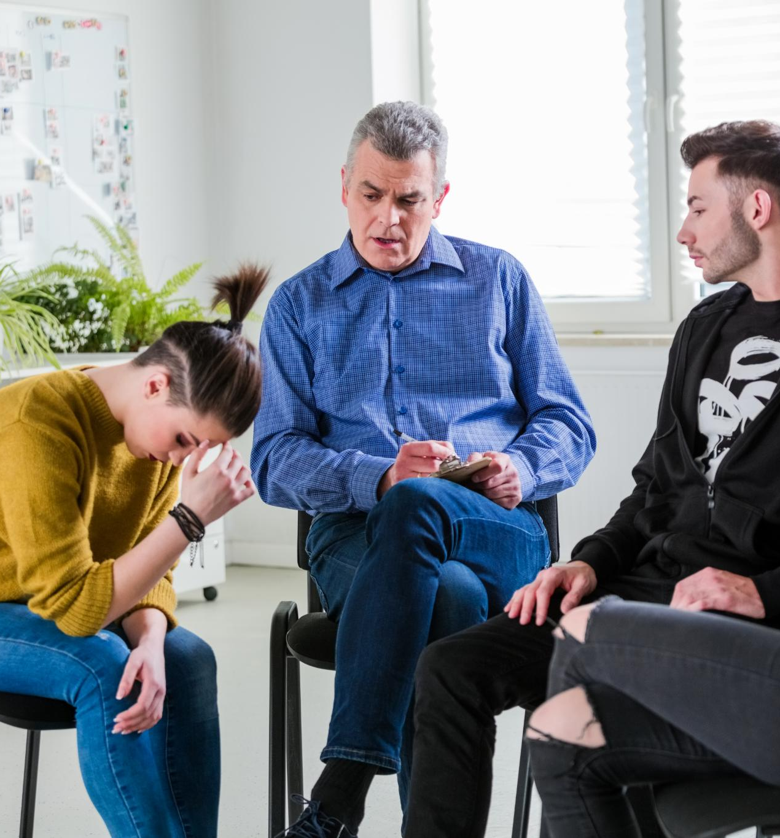
Providing Comfort in Times of Loss and Crisis
Empathetic Presence
  Chaplains provide a compassionate and understanding presence to those experiencing grief or crisis.
Spiritual Consolation
  Prayer and spiritual guidance help families find peace and solace during difficult times if they want it.
Notes:
---
Chaplains assist families and members facing grief or crisis by offering empathetic presence, prayer, and spiritual consolation.
Image source: Microsoft 365 content library

Slide 12
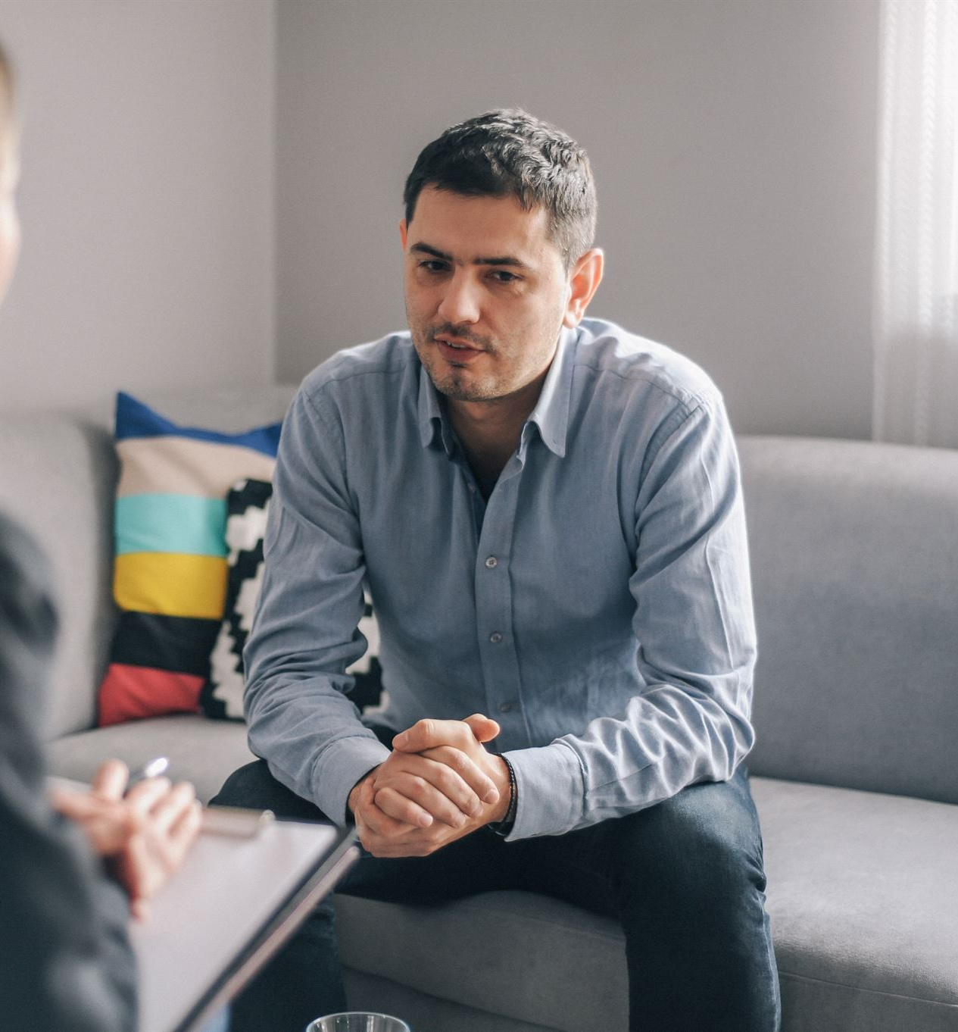
Offering Counseling and Emotional Support
Confidential Counseling
  Chaplains offer private and confidential counseling to support individuals facing personal difficulties.
Emotional Support
  Emotional support helps members manage stress and service-related challenges effectively.
  NOTE: We are not counselors as in professional counselors. However, we are responsible to refer folks to professional counselors to insure they have an opportunity to receive the care they need. We can not make them go however.
Notes:
---
Trained chaplains provide confidential counseling and emotional support to help members cope with personal and service-related challenges.
Image source: Microsoft 365 content library

Slide 13

Connecting with Community Resources
Role of Chaplains
  Chaplains serve as vital links connecting individuals to essential community resources for holistic care.
Veterans’ Services Support
  Chaplains facilitate access to specialized veterans’ services to address their unique needs. ie. The VA hospital system, both in VA clinics and VA hospitals.
Healthcare and Social Services
  They coordinate with healthcare providers and social services to ensure comprehensive care for individuals. We refer only; we can not make anyone receive services.
Notes:
---
Chaplains act as liaisons to external support networks, including veterans’ services, healthcare providers, and social services, ensuring comprehensive care.
Image source: Microsoft 365 content library

Slide 14
Collaboration and Continuing Education
Notes:
Ongoing collaboration and education strengthen chaplains’ abilities to serve effectively, fostering leadership development and sharing best practices.

Slide 15
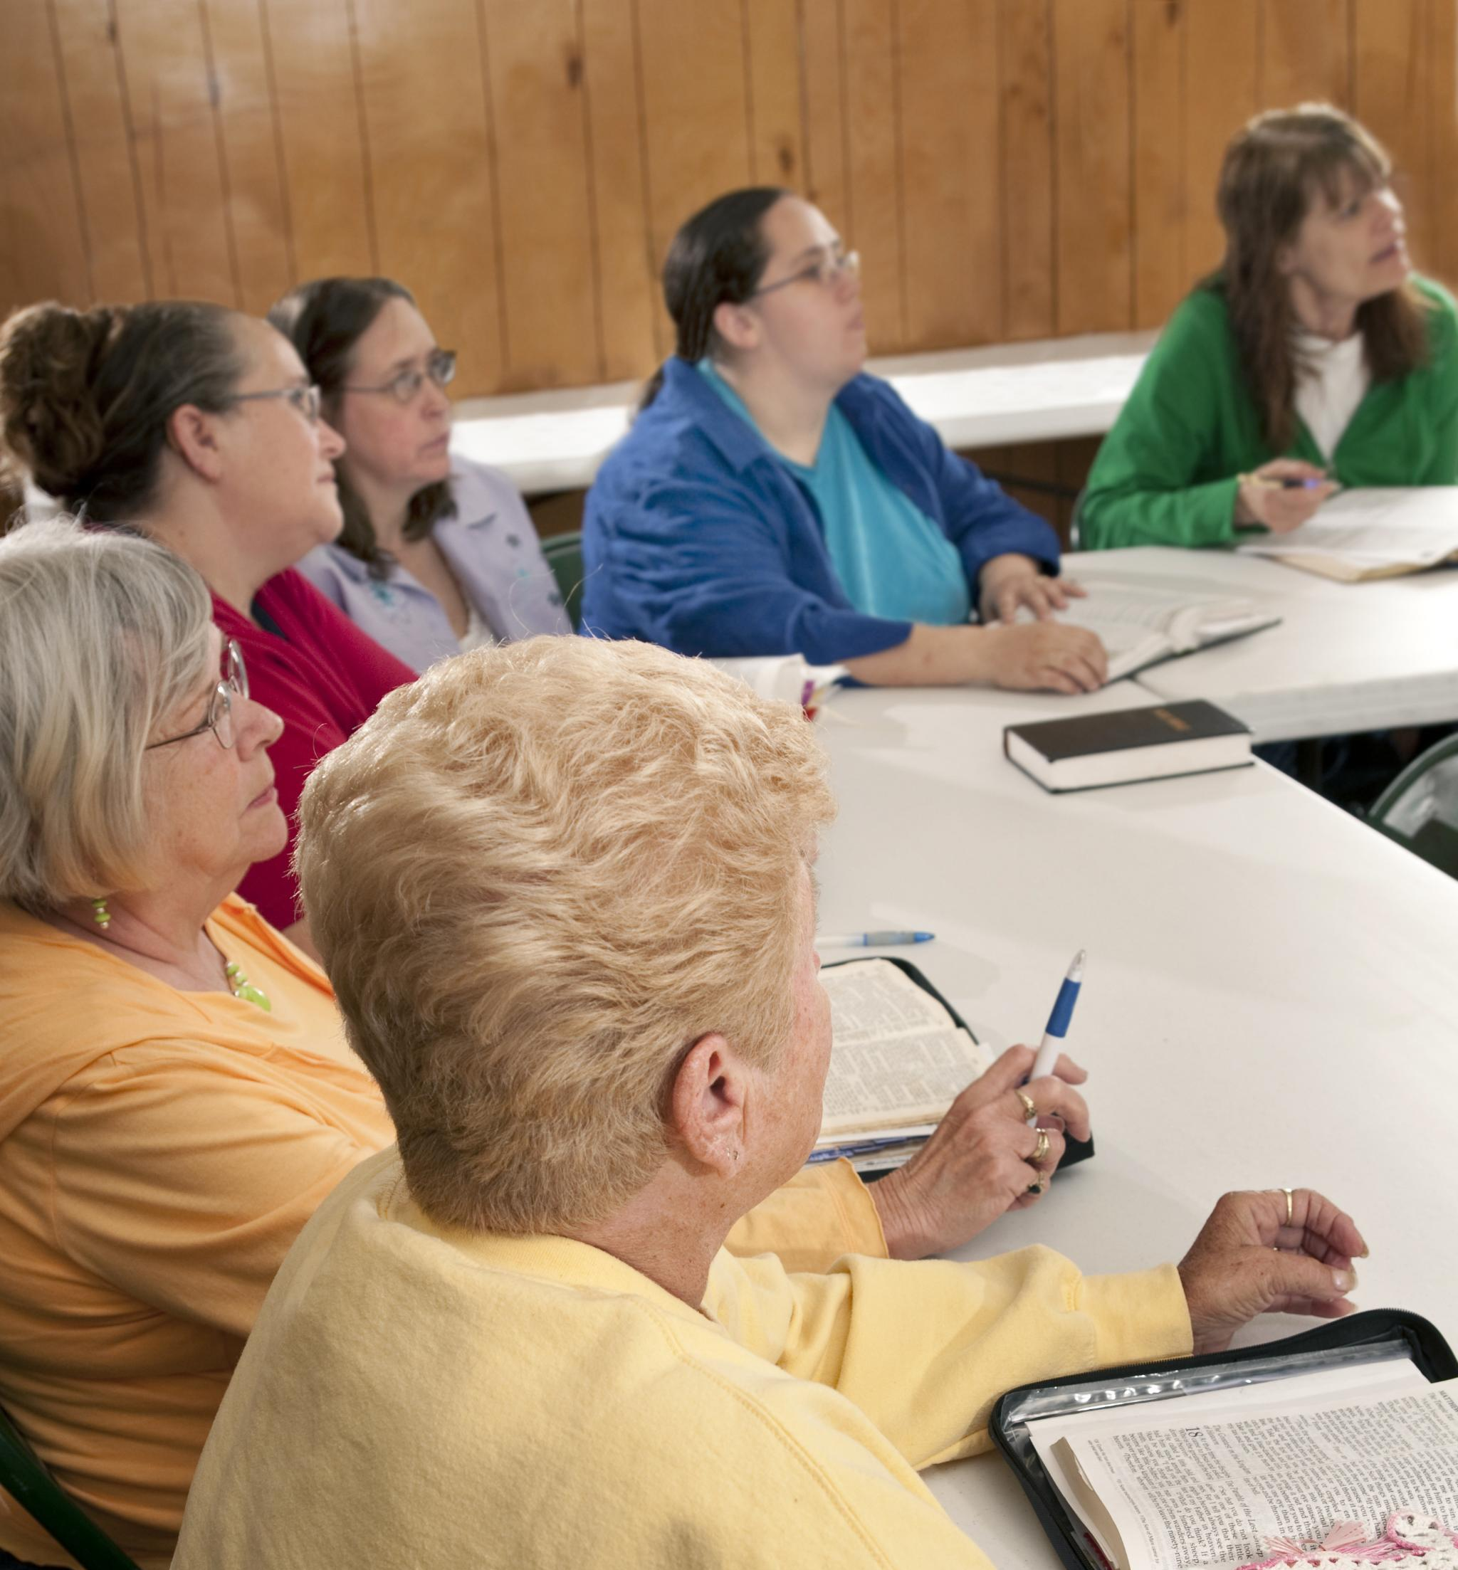
Working with Leadership and Volunteers
Collaboration with Leadership
  Chaplains work closely with organizational leaders to align spiritual support with mission goals and activities.
  Each leader has a different view of what a Chaplain should or should not do. Sitting down with the leader early in the year and developing a communication is very important.
Engagement with Volunteers
  Chaplains always need help! Always have an assistant where possible. This is of major importance in emergencies or when you are not available!
Notes:
---
Chaplains coordinate closely with VFW leadership and volunteers to integrate spiritual support into organizational activities and missions.
Image source: Microsoft 365 content library

Slide 16
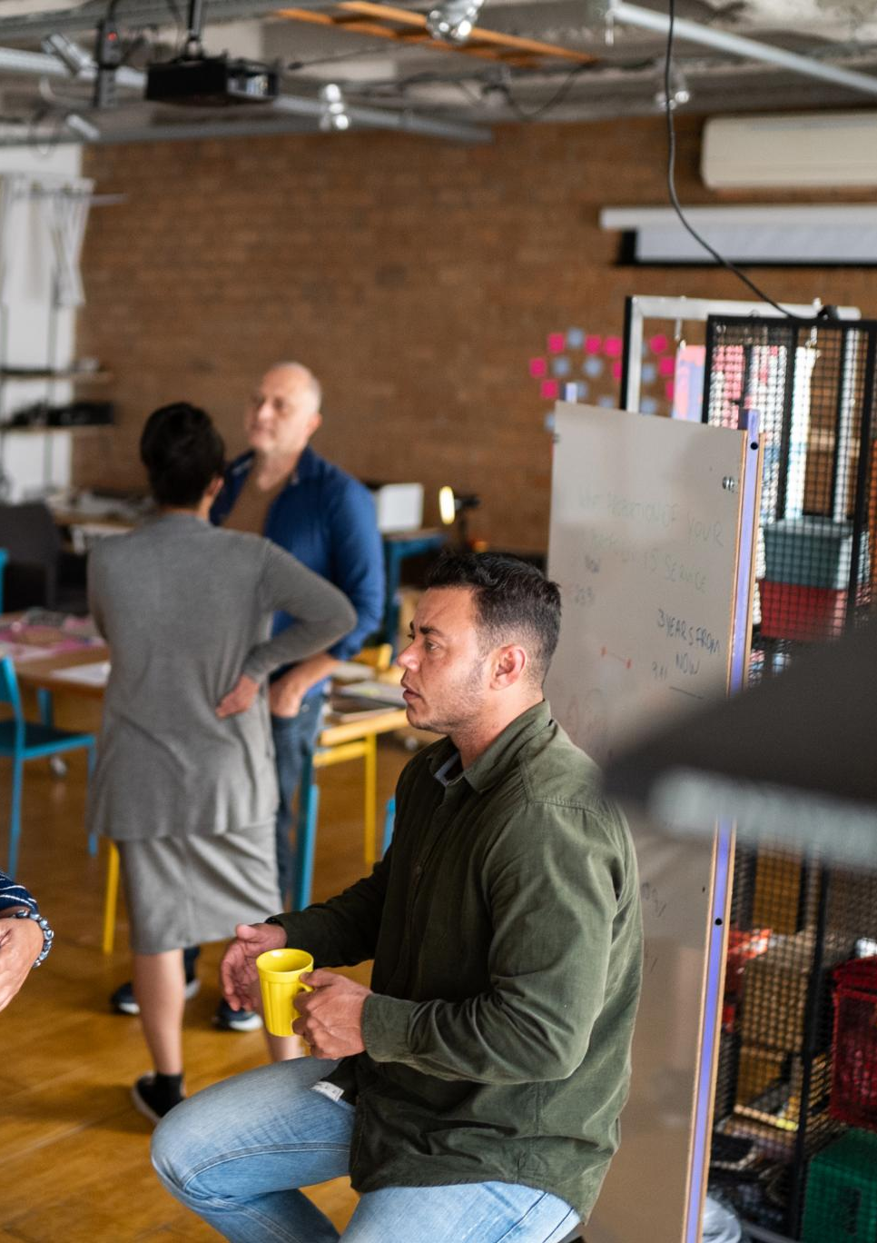

Opportunities for Ongoing Training for VFW Chaplains
Continuous Learning
  Ongoing training ensures chaplains maintain up-to-date skills relevant to their roles. We in the VFW do this though District training, Department training, and National Training.
Workshops and Seminars
  Workshops and seminars provide focused learning opportunities to address emerging community needs. A chaplain’s workshop is presented once a year at the VFW National Convention.
  The VFW Chaplain Committee offers Zoom training at the National Level on the 3d Thursday of the month at 7:30 p.m. CST. August though May each year.
National VFW Website
  https://lotcs.org/vfw_chaplain.htm.
  Monthly email to all Chaplains that sign up!
  Email Peter Hook at: PeterHook@verizon.net request to be put on the mailing list!
Notes:
---
Chaplain training continues through workshops, seminars, and conferences to keep skills current and address emerging needs within the veteran community.
Image source: Microsoft 365 content library

Slide 17

Best Practices and Mentorship
Experienced Mentorship
  Experienced chaplains provide guidance to new members for improved chaplaincy skills and professionalism.
Sharing Proven Approaches
  Mentors share effective strategies and insights to enhance chaplains' effectiveness and professionalism.
  MENTORS ARE VERY IMPORTANT!
  VFW National Chaplain Committee POC’s (Points of Contact)
  Darren Atkins - Current National Chaplain docapothecary@gmail.com
  Peter Hook (Past National Chaplain) PeterHook@verizon.net
  David Frei (Past National Chaplain) vfwdfrei@gmail.com
  Deborah Halter (Past National Chaplain) dihalter@gmail.com
  Jim Jenkins (Past VFW National Chaplain) kschaplain@att.net
  Frank Correa (Western Conference Chaplain) fcorreavfw@gmail.com
  Dale Iannello “Chappy” (“I.T.” Chaplain) Washington State Chaplain chaplaindale@gmail.co
Notes:
---
Experienced chaplains mentor new members, sharing insights and proven approaches to enhance the effectiveness and professionalism of the chaplaincy.
Image source: Microsoft 365 content library

Slide 18
On ward to the Website!
https://lotcs.org/vfw_chaplain.html
Notes:
Chaplains in the VFW and Auxiliary are essential spiritual leaders providing support, guidance, and comfort. Comprehensive training and collaboration ensure they meet the evolving needs of members and families effectively.

